Slide 1
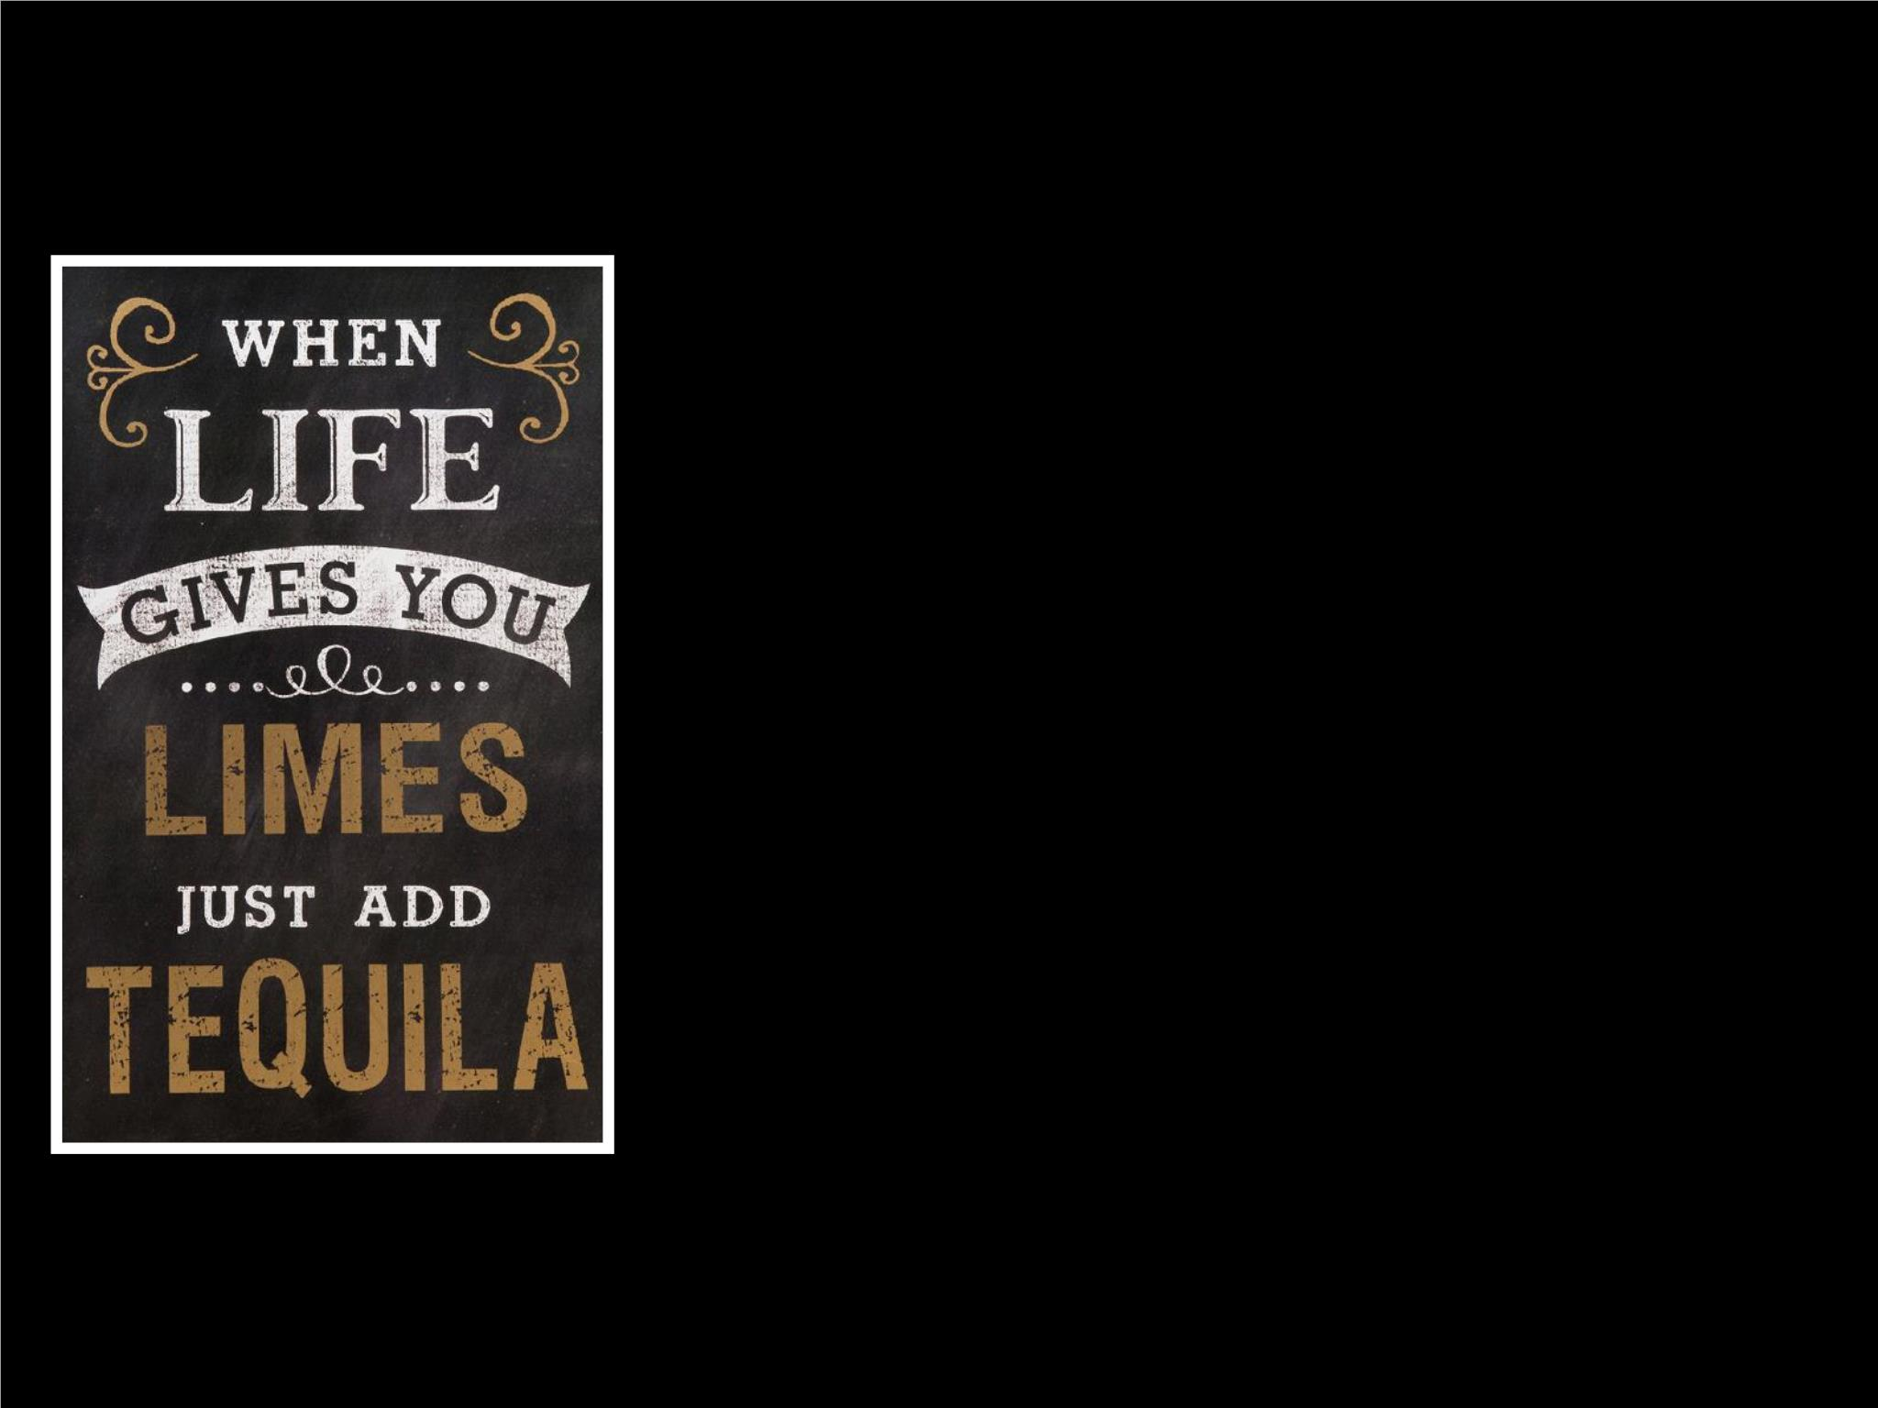
“Why Should I Trust You?”
Explaining the Predictions
of Any Classiﬁer
Presented at KDD 2016

Slide 2

Motivation
1. Is the model’s prediction on a speciﬁc input trustworthy?ꢀ
• Individual decision-makingꢀ
2. Is the model itself trustworthy?ꢀ
• Deployment, model selection

Slide 3

Proposal
Lipton
•
•
Understandable models = Trustworthy modelsꢀ
Explanations help us understand model predictionsꢀ
•
Solves Problem 1: user can judge explanations easilyꢀ
•
Solves Problem 2: representative set of explanationsꢀ
•
Interpretable models give us explanationsꢀ
•
Also important: local ﬁdelity, model agnosticism
Poursabzi-Sangdeh et. al.

Slide 4
Contributions
•
•
•
LIME, locally approximating black-box classiﬁer with
interpretable classiﬁerꢀ
SP-LIME, ﬁnding near-optimal set of explanations to
evaluate overall model performanceꢀ
Simulated and real-life human experiments

Slide 5
Agenda
•
•
•
•
Looking at LIME
Looking at SP-LIMEꢀ
Simulated experiments: S1, S2, S3ꢀ
Human experiments: H1, H2, H3

Slide 6
Agenda
•
Looking at LIME
•
•
Setupꢀ
Objective Functionꢀ
•
•
G =
Case where linear modelsꢀ
Results
•
•
•
Looking at SP-LIMEꢀ
Simulated experiments: S1, S2, S3ꢀ
Human experiments: H1, H2, H3

Slide 7

LIME: Setup
Black-box classiﬁer
f
Y ∈ ℝ
k
X ∈ ℝ^{d}
Classiﬁcation probability
for class k
Feature space
G = {g}
X′ ∈ ℝ^{d′}
Family of interpretable models
Interpretable feature space
g
k
Different learnt for each and

Slide 8
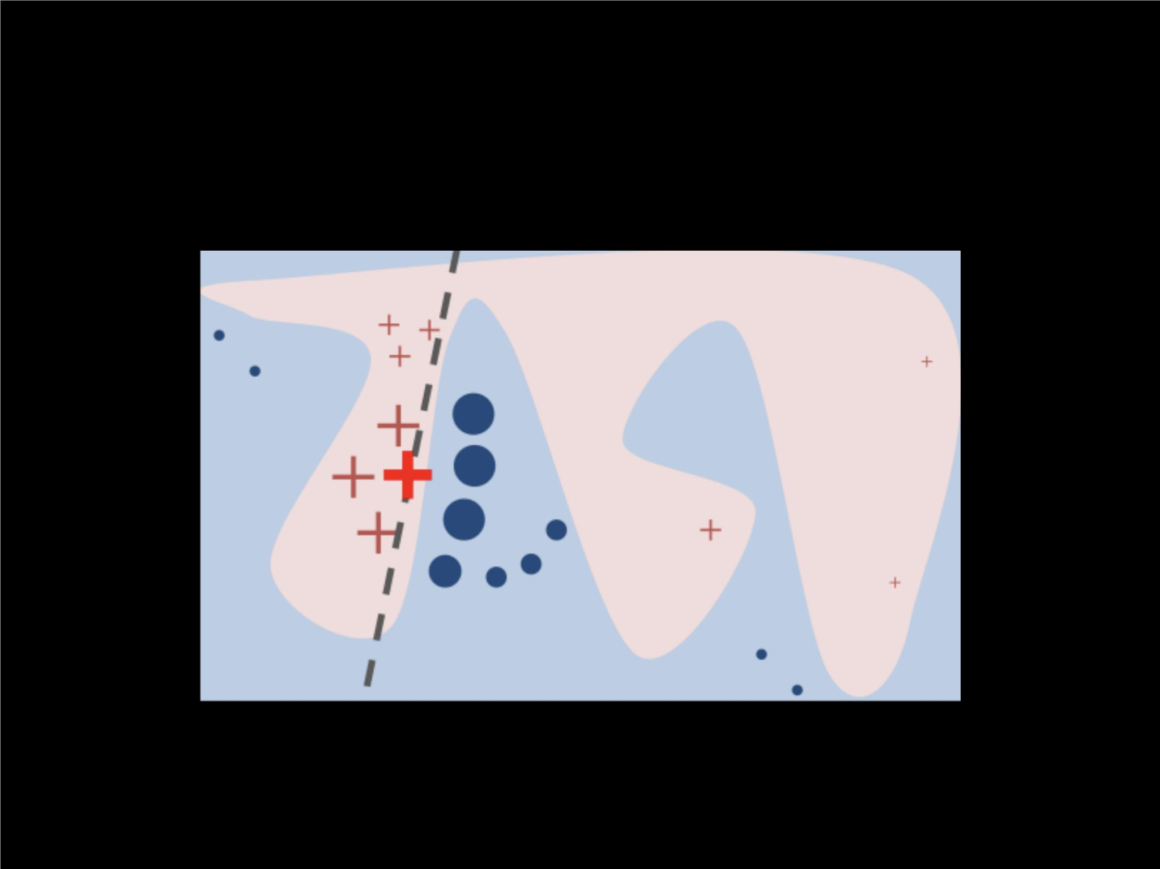
LIME: Intuition

Slide 9
LIME: Objective Function
ξ(x) = arg m in L(f, g, π ) + Ω(g)
x
g∈G
Fidelity score
Complexity score
(for interpretability)
(for local ﬁdelity)
π (z)
x
Distance metric between and (in feature space!)

Slide 10
LIME: Sparse Linear Models
⊤
g(z′) = w z′
g
The linear models we all know and love!
π (z) = e
2 2
−D(x,z) /σ
x
Exponential kernel
1. Get x′from
3. Recover from z′
( )²
L(f, g, π ) = ∑ π (z) f(z) − g(z′)
x
x
z′∈ℤ
2. Uniform sampling of z′from
nonzero elements of x′
= *Single* point of interest
x′= POI in interpretable space
z′= *Many* neighbors of x′
= Many z′back to feature space

Slide 11
LIME: Sparse Linear Models
Ω(g) = ∞ ⋅ ꢀ[∥w ∥ > K]
g 0
L -norm: number of non-zero elements in the vector
0
Oh no! Objective function cannot be directly optimized!

Slide 12
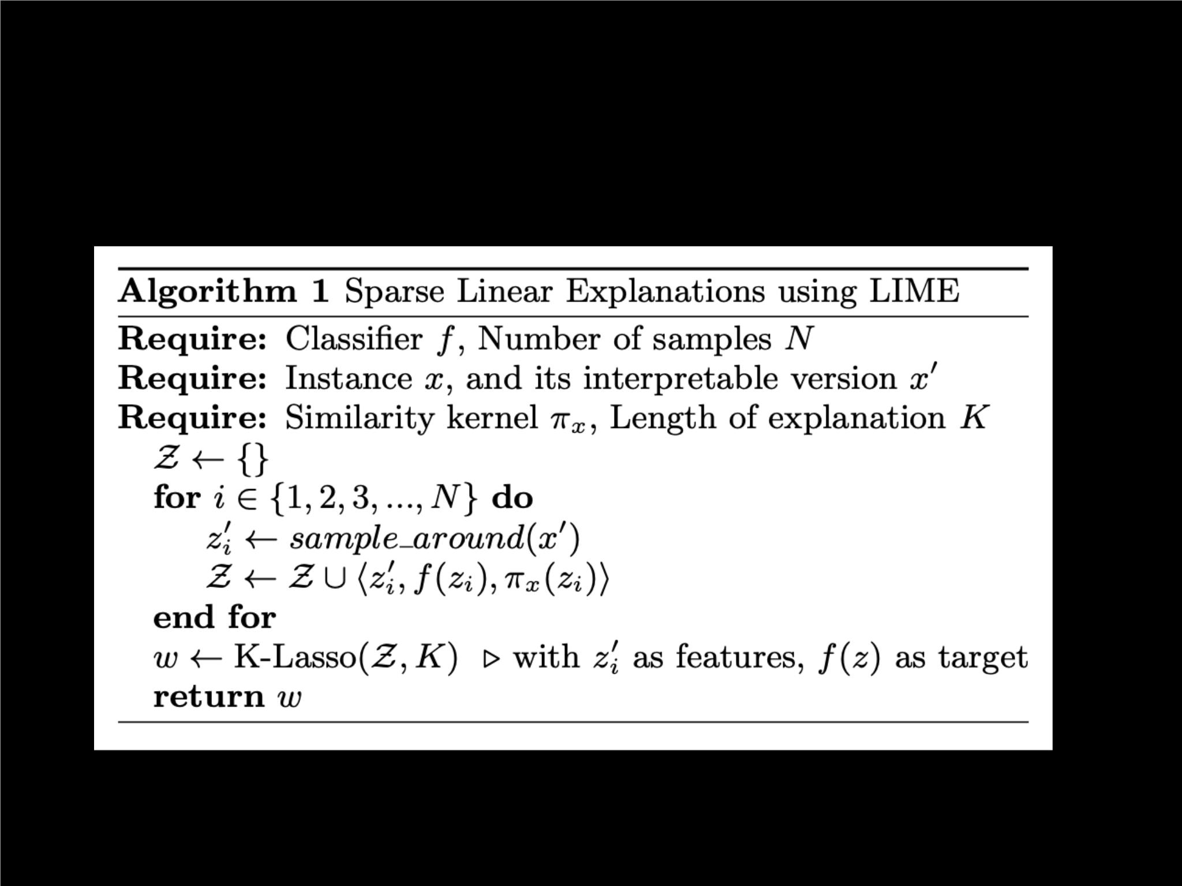
LIME: Algorithm

Slide 13
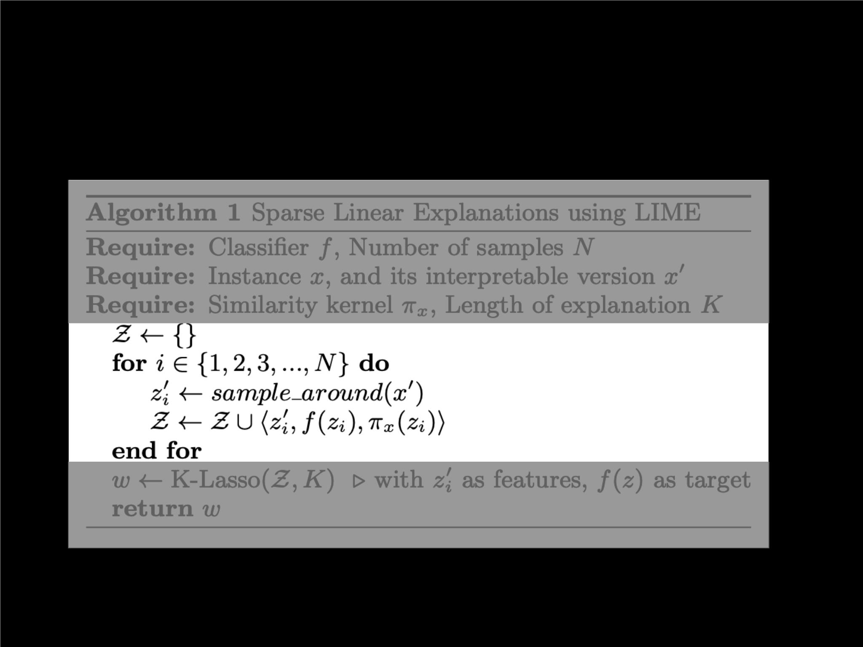
LIME: Algorithm
Just collecting samples!

Slide 14
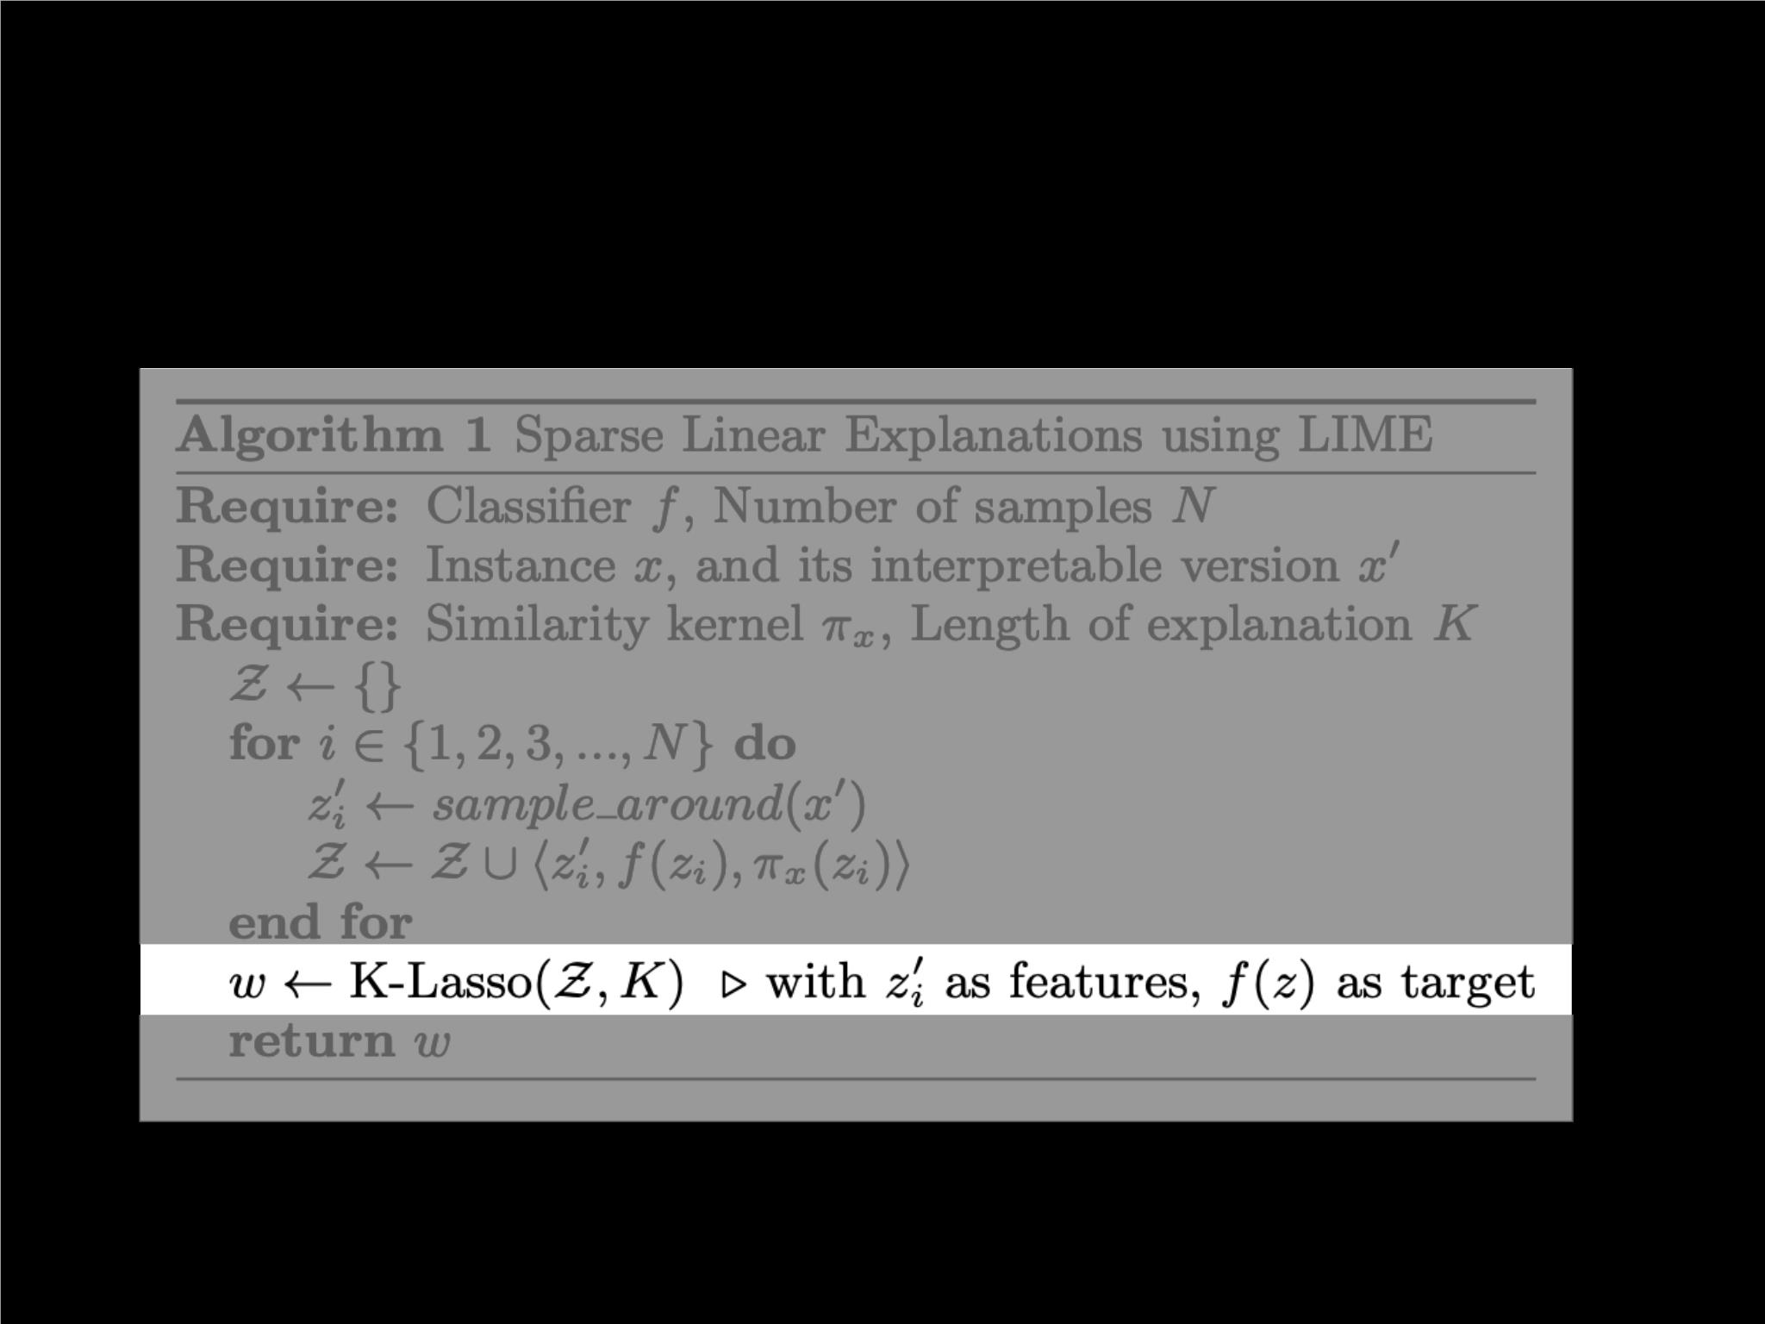
LIME: Algorithm
Lasso “feature” selection

Slide 15

LIME: K-Lasso
def least_angle_regression(Z, K):
w = 0
while l0_norm(w) < K:
j = find_most_correlated_dimension(Z, w)
w = increment_dimension(w)
return w
1. Least-angle
regression (LARS)
def increment_dimension(w, epsilon=*):
return (1 + epsilon) * w
2. Least-squares regression on L( f, g, π ) using the K selected dimensions
x

Slide 16
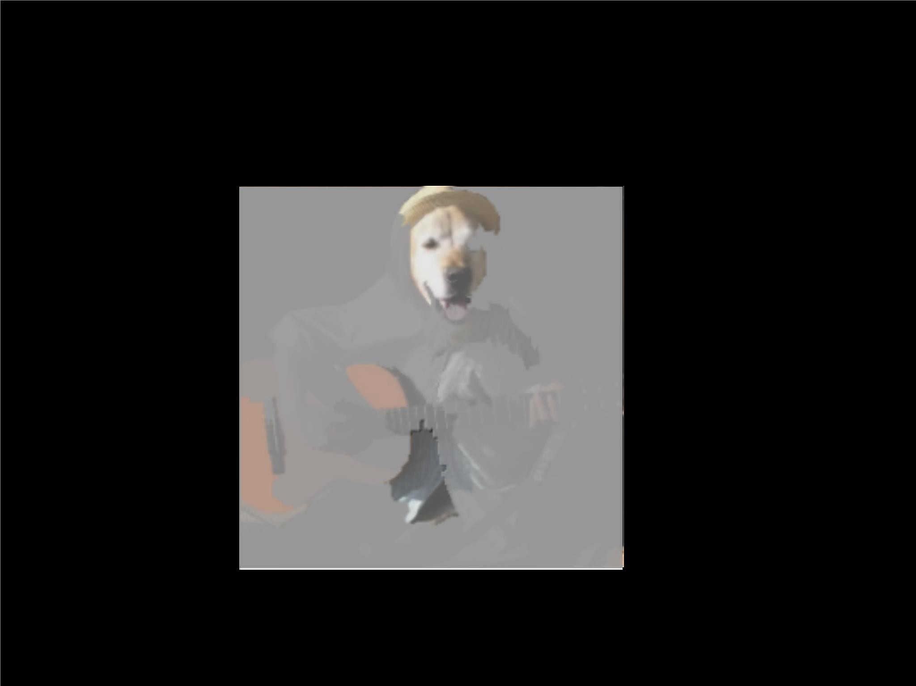
LIME: Results
EAlcLeoac ubt rsri atci dcgougr iut iat ra r
X = M × N × 3 tensor
X′ = binary space of
“super-pixel” presence

Slide 17
Agenda
•
•
Looking at LIME
Looking at SP-LIMEꢀ
•
Setupꢀ
•
Pick Problemꢀ
•
Submodular Pick Algorithmꢀ
•
•
Simulated experiments: S1, S2, S3ꢀ
Human experiments: H1, H2, H3

Slide 18

SP-LIME: Setup
•
•
Question: How to choose a representative set of
explanations (examples) to judge the model as a whole?ꢀ
Intuition: We want a set of examples that:ꢀ
•
Maximize the number of interpretable features usedꢀ
•
Weighted by importance of each feature
d′
Reminder: in ℝ space!

Slide 19
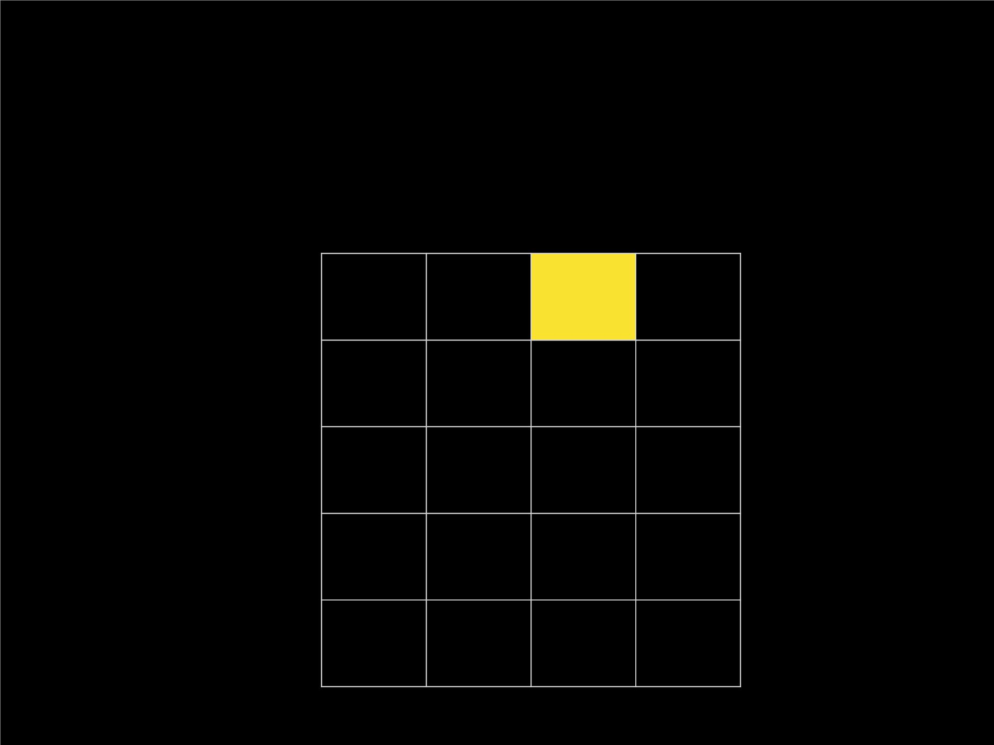
SP-LIME: Explanation Matrix W
d′columns
(no. of interpretable features)
W = |w |
ij
g ,j
i
rows
(no. of instances)
Feature importance
for each example

Slide 20
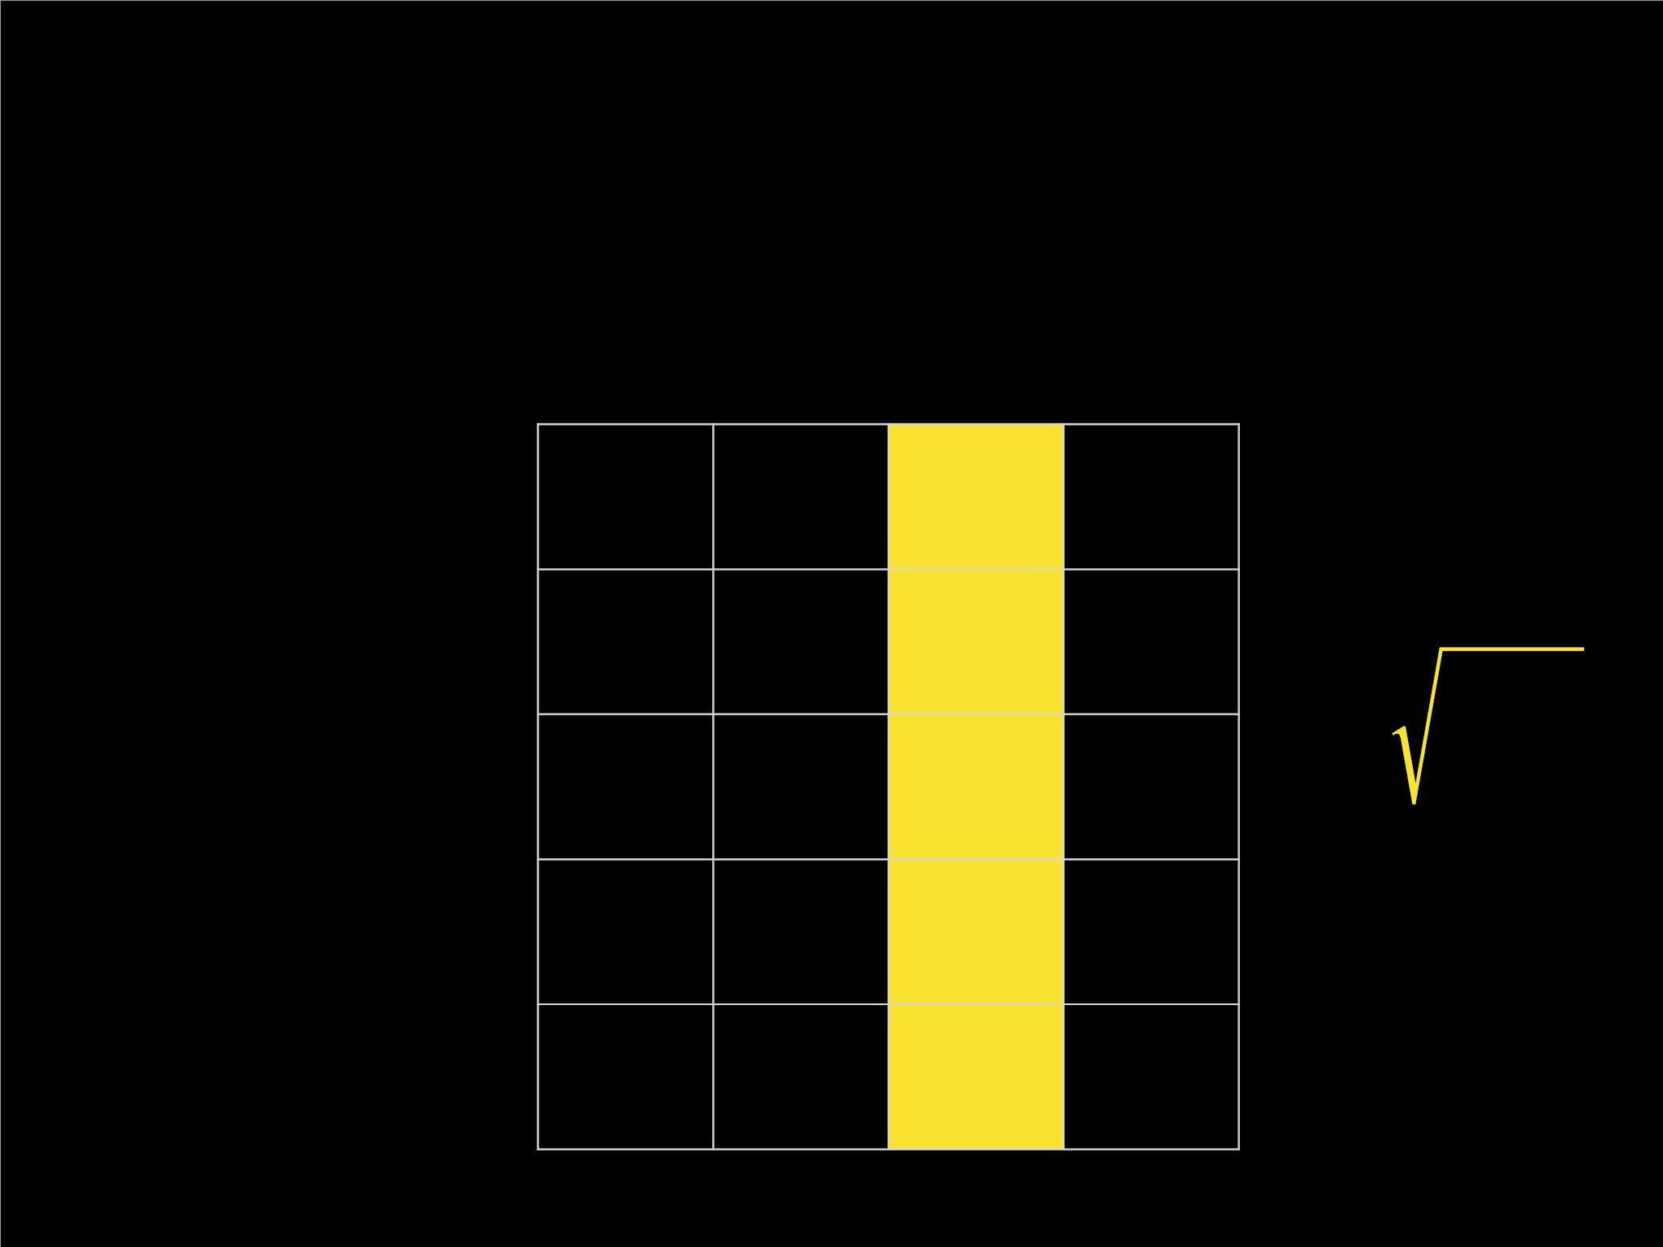
SP-LIME: Explanation Matrix W
d′columns
(no. of interpretable features)
I = ∑ W
rows
(no. of instances)
j
ij
i
global
feature importance

Slide 21
SP-LIME: Pick Problem
d′
c(V, W, I) = ∑ ꢀ[∃i ∈ V : W > 0] ⋅ I
ij
j
j
coverage for some set of examples V:
sum of importances of features covered by those examples
Pick(W, I) = arg m ax c(V, W, I)
V:|V|≤B
Find the set V with highest coverage, subject to budget B

Slide 22
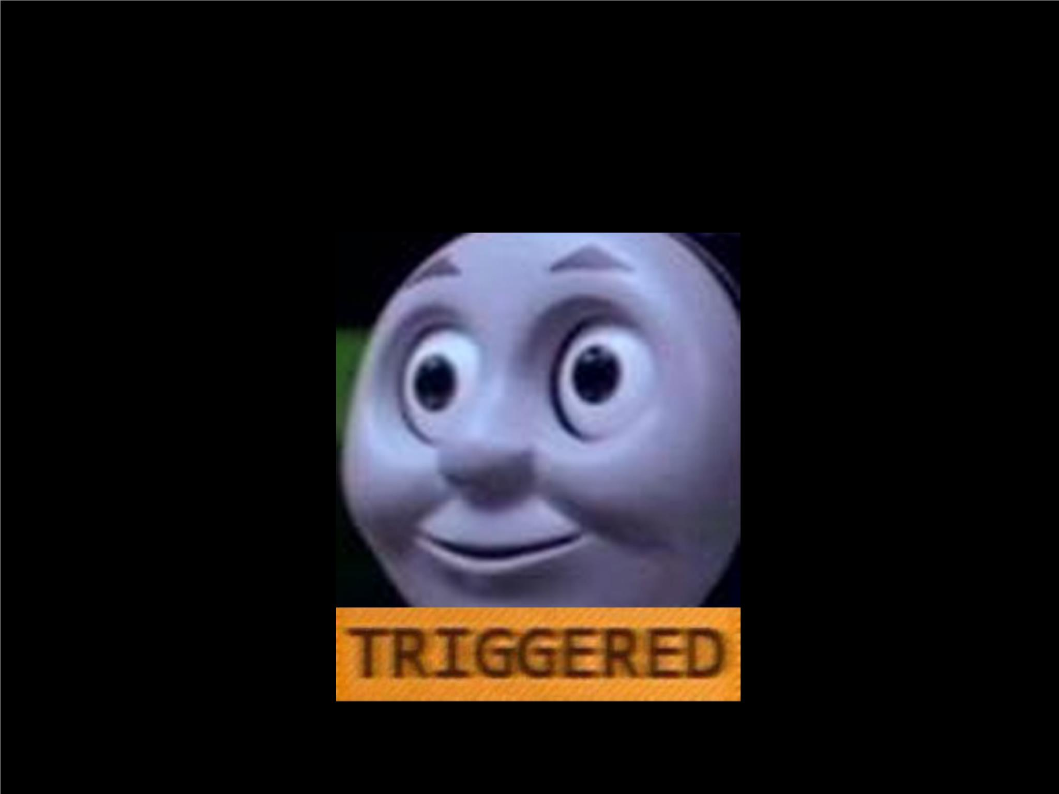
SP-LIME: Submodular Pick Algorithm
• c(V, W, I)
is a submodular function:
c(S ∪ {i}, W, I) −
if S ⊆ T, i ∉ T
c(T, W, I)
•
•
Diminishing ret
Déjà vu?
Interpretable D
t. al.

Slide 23
SP-LIME: Submodular Pick Algorithm
•
The same thing? Not quite!ꢀ
•
Objective in IDS is not monotone, but coverage is:
c(S, W, I) ≤ c(T, W, I) ⇔ S ⊆ Tꢀ
•
Good news for us!ꢀ
•
We don’t need smooth local search!
Greedy construction works.

Slide 24
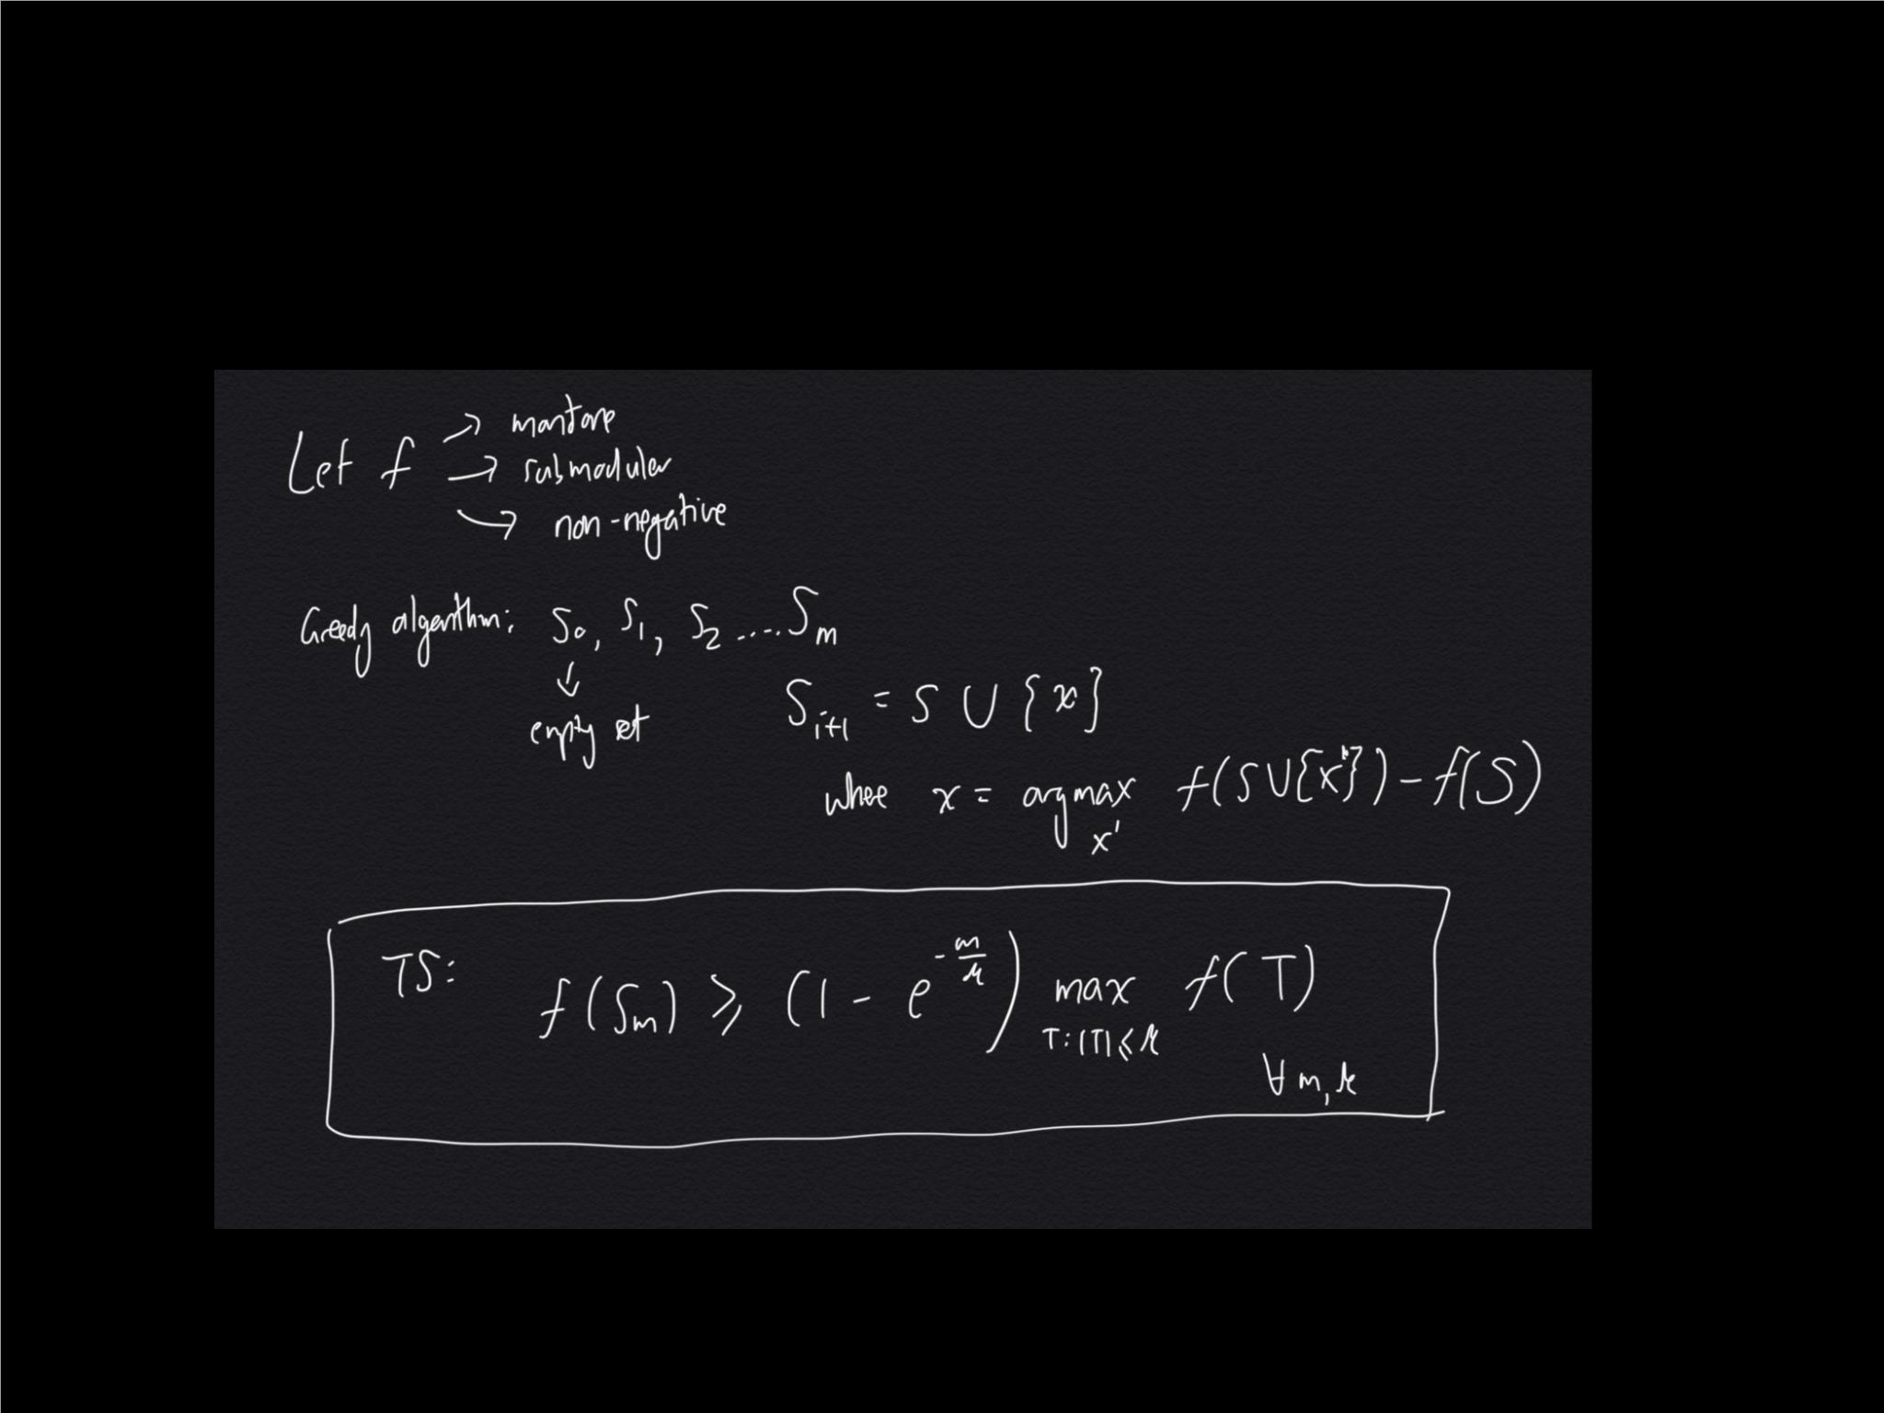
SP-LIME: Submodular Pick Algorithm

Slide 25
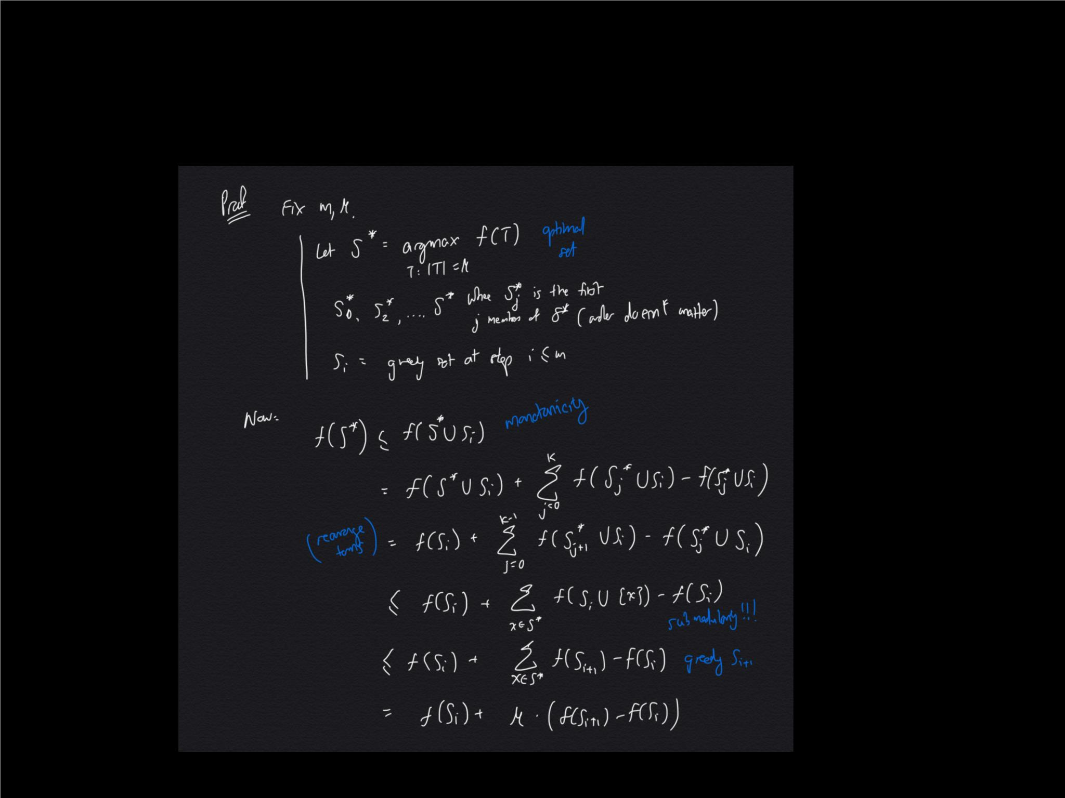
SP-LIME: Submodular Pick Algorithm

Slide 26
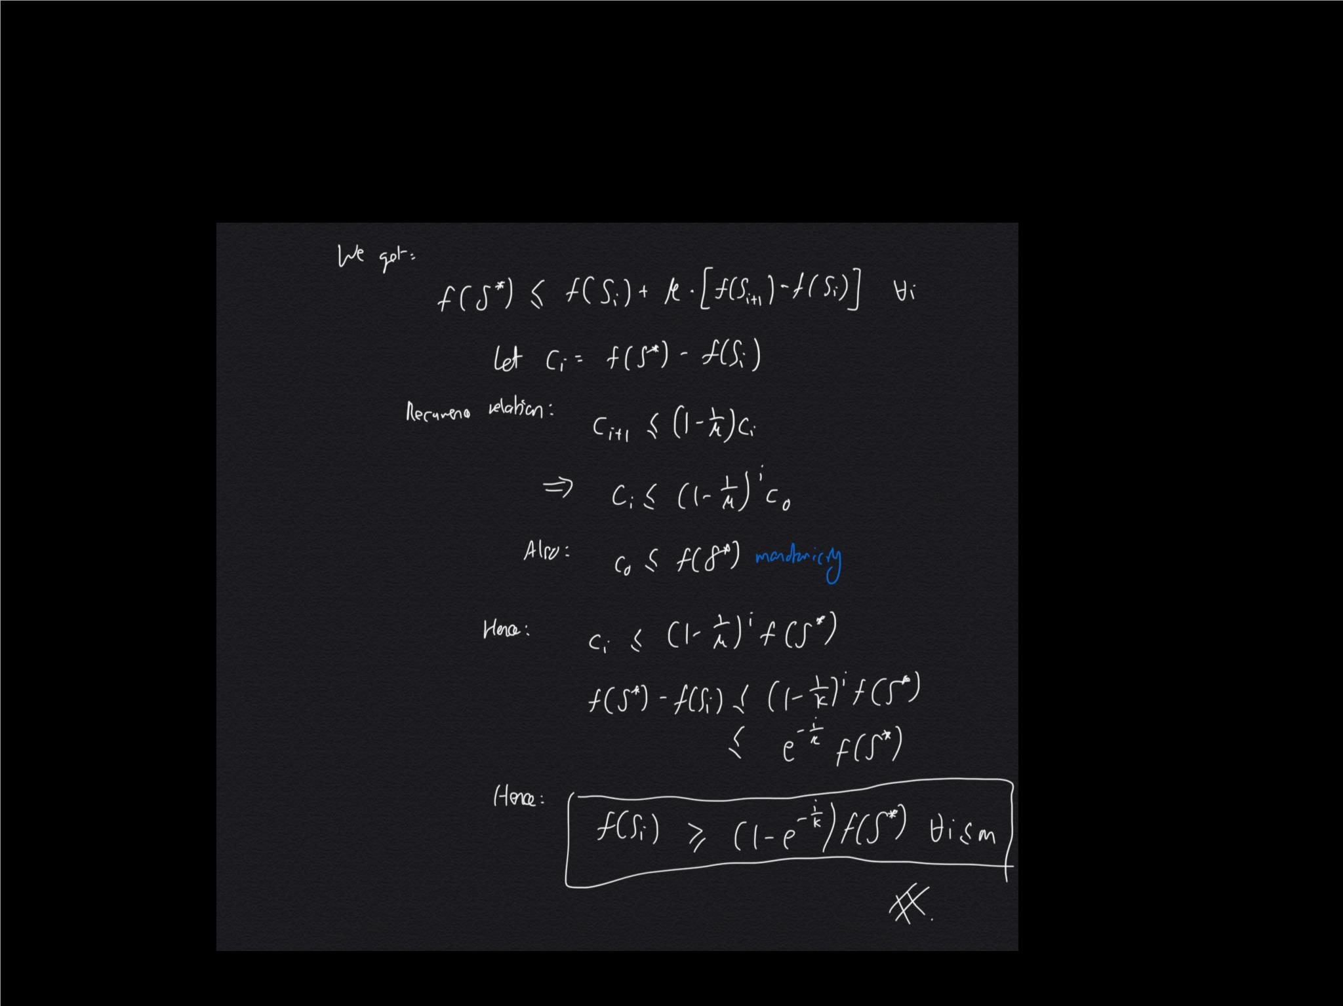
SP-LIME: Submodular Pick Algorithm

Slide 27
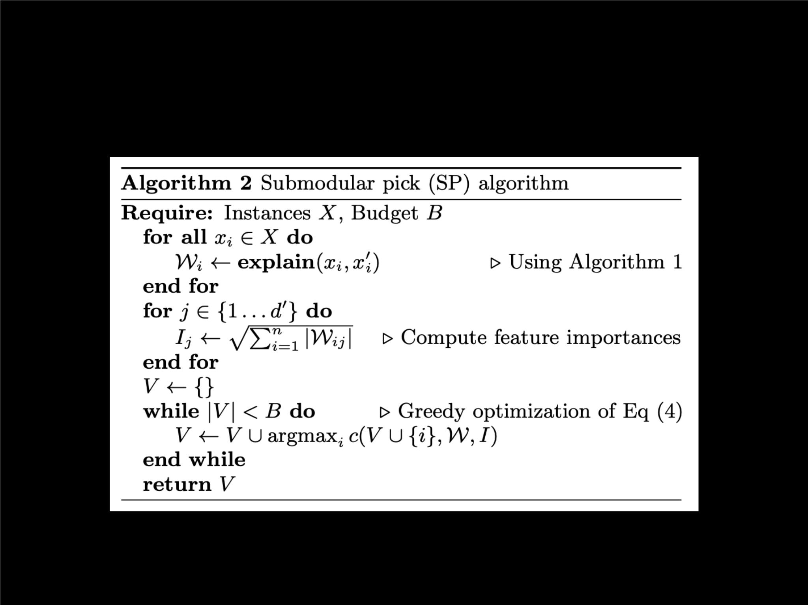
SP-LIME: Submodular Pick Algorithm

Slide 28
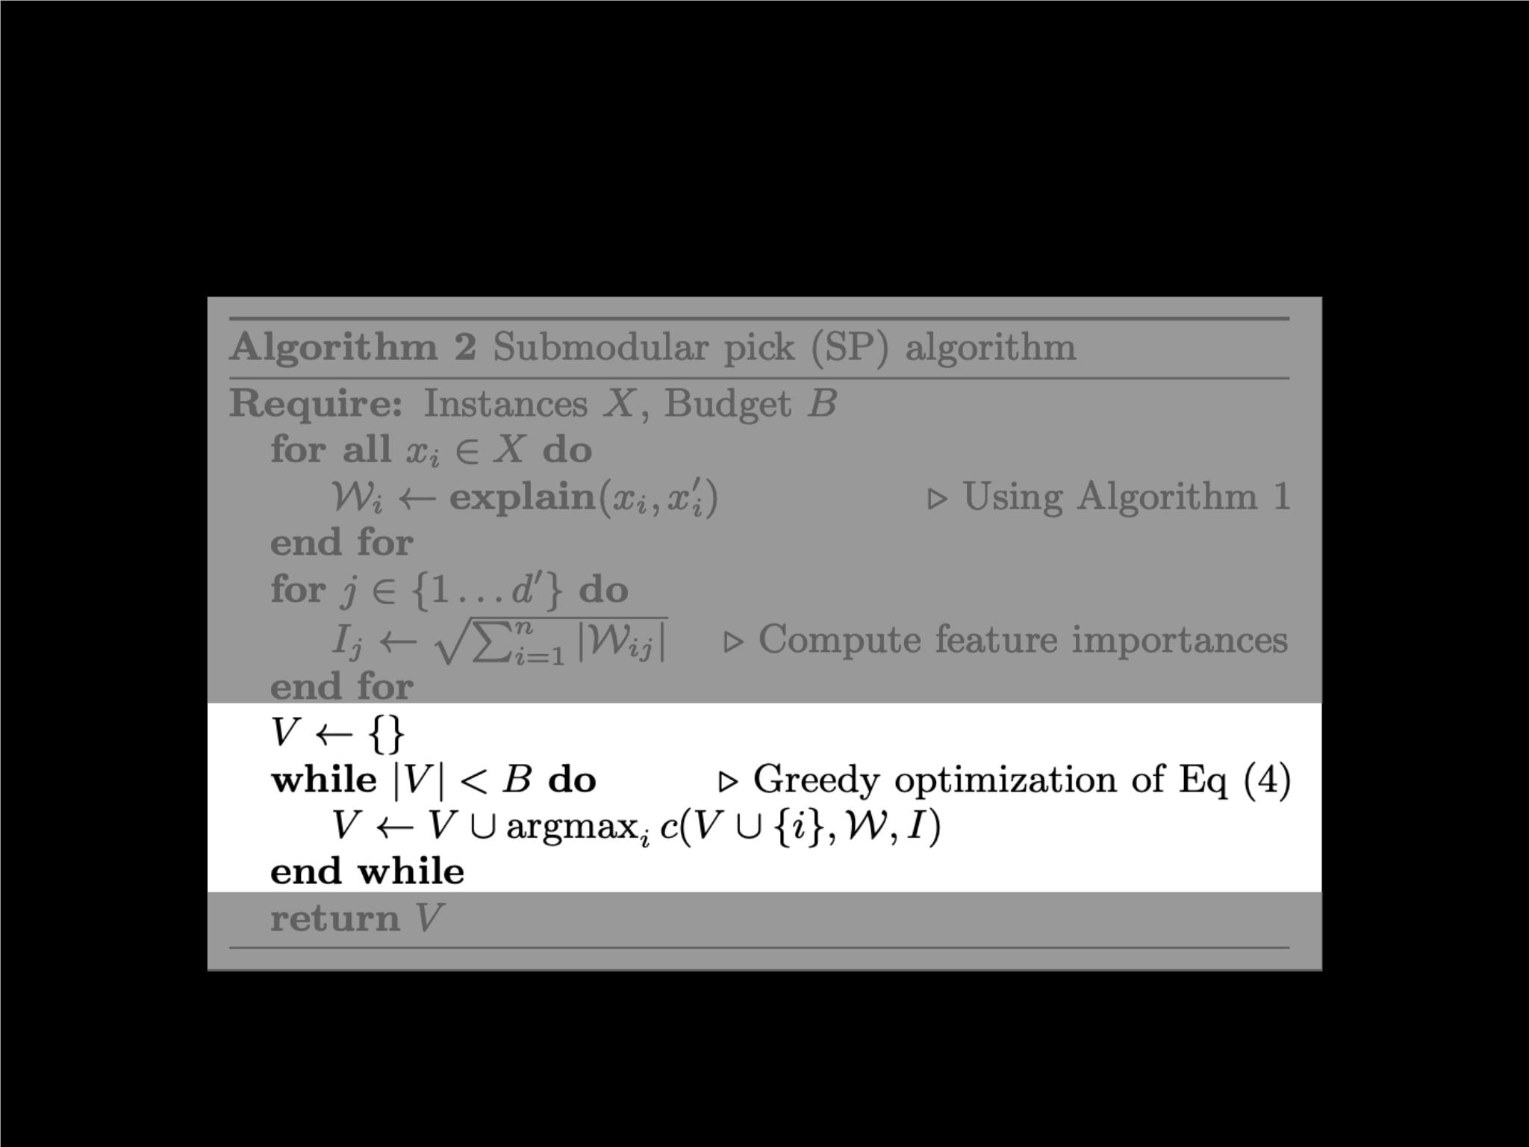
SP-LIME: Submodular Pick Algorithm

Slide 29
Agenda
•
•
•
•
Looking at LIME
Looking at SP-LIMEꢀ
Simulated experiments: S1, S2, S3ꢀ
Human experiments: H1, H2, H3

Slide 30
Simulations: Setup
• f {
}
= LR, DT, NN, SVM ꢀ
•
•
{
}
Explainers = lime, parzen, greedy, random ꢀ
Global explainers =
{ SP-LIME, RP-LIME, SP-greedy, RP-greedy }ꢀ
•
Classiﬁcation problem: Sentiment Analysis

Slide 31
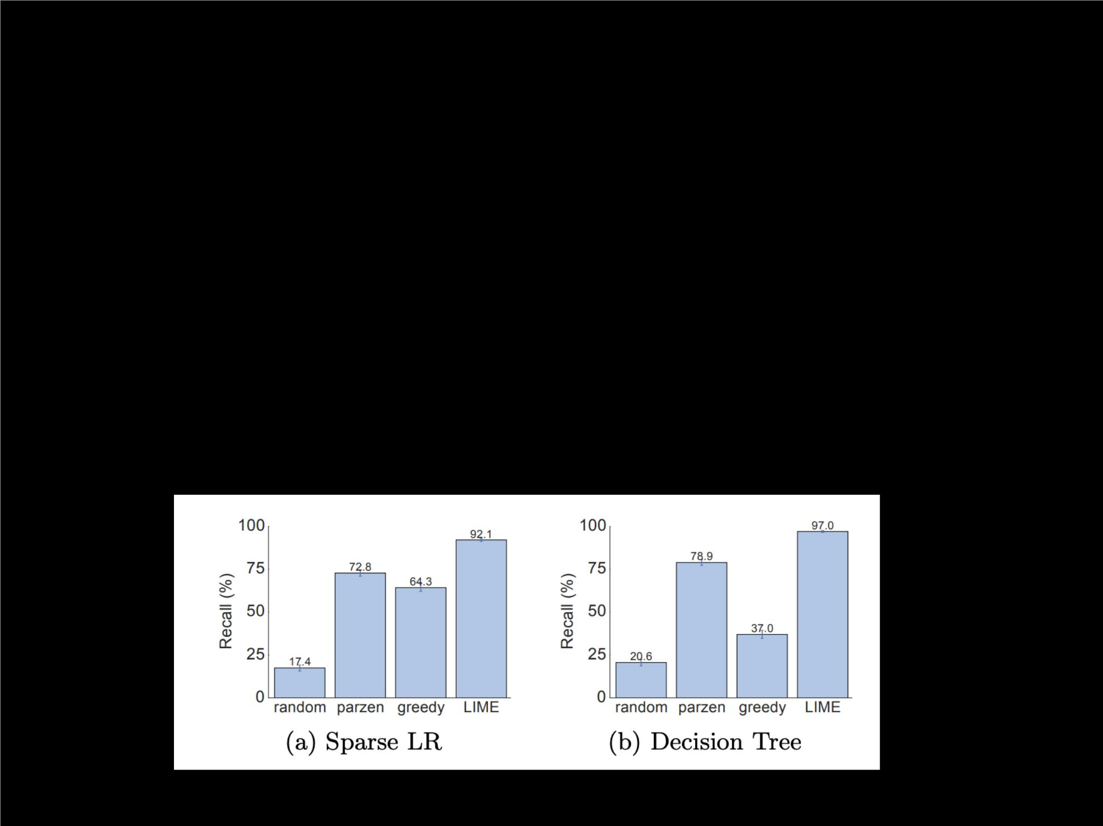
S1: Explanations a re
faithful to the model.
• f {
}
= sparse LR, DT ꢀ
•
Compare features selected by LR and DT with features
selected by all 4 explanations.ꢀ
•
Evaluation: recall = TP / (TP + FN)

Slide 32
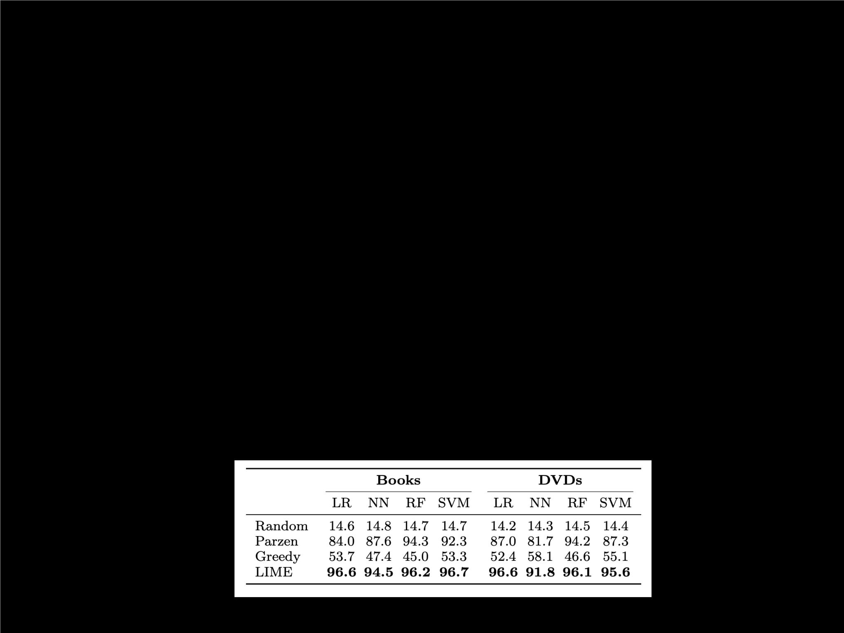
S2: Individual LIME
explanations can be trusted.
•
Recall that trustworthiness must be evaluated wrt humansꢀ
•
Simulated “human”:
75% trustworthy features, 25% untrustworthy ꢀ
•
f
Black-box labeled as trustworthy for point if prediction
doesn’t change after removing untrustworthy featuresꢀ
•
Deﬁned similarly for each explainer

Slide 33
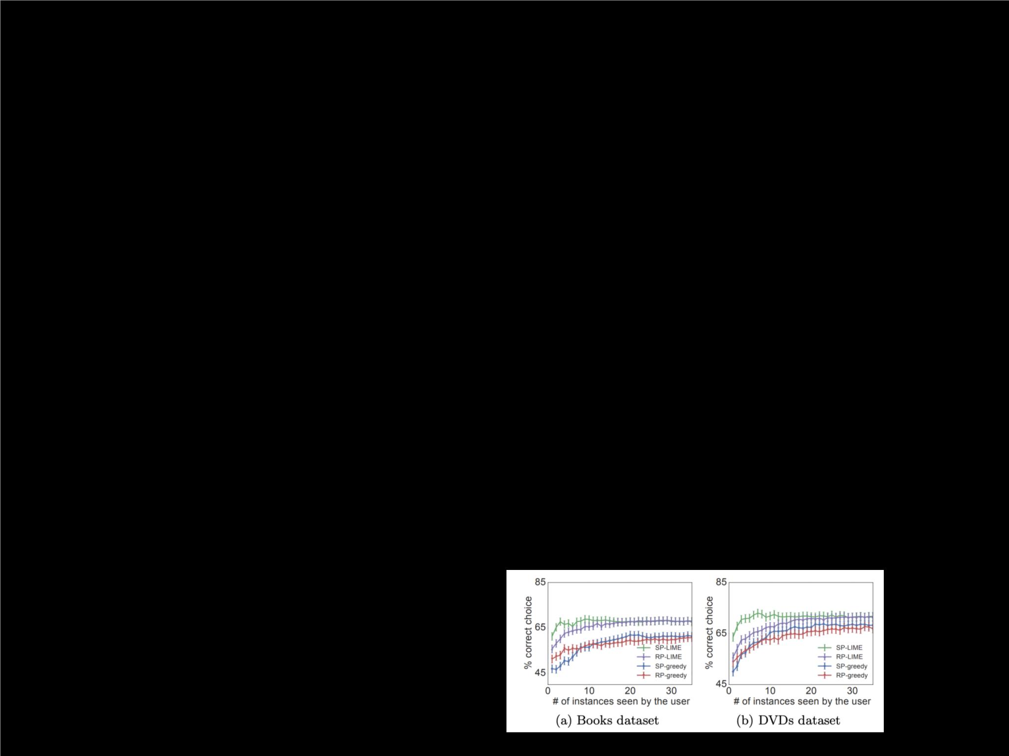
S3: SP-LIME can be trusted
to evaluate a model globally.
•
Train 2 classiﬁers on both real and artiﬁcial featuresꢀ
•
•
Same validation accuracy, diﬀerent test accuracyꢀ
Hence: there is a ground-truth better classiﬁerꢀ
•
•
V
Global explainers each pick some set , and computes
how many untrustworthy predictions (out of |V|) each
classiﬁer makesꢀ
Selects the classiﬁer with fewer untrustworthy predictions
as the better classiﬁer

Slide 34
Human Experiments: Setup
•
Classiﬁcation problem: “Christian” and “Atheism”
datasetsꢀ
•
Hidden held-out “religion” dataset (for testing)

Slide 35
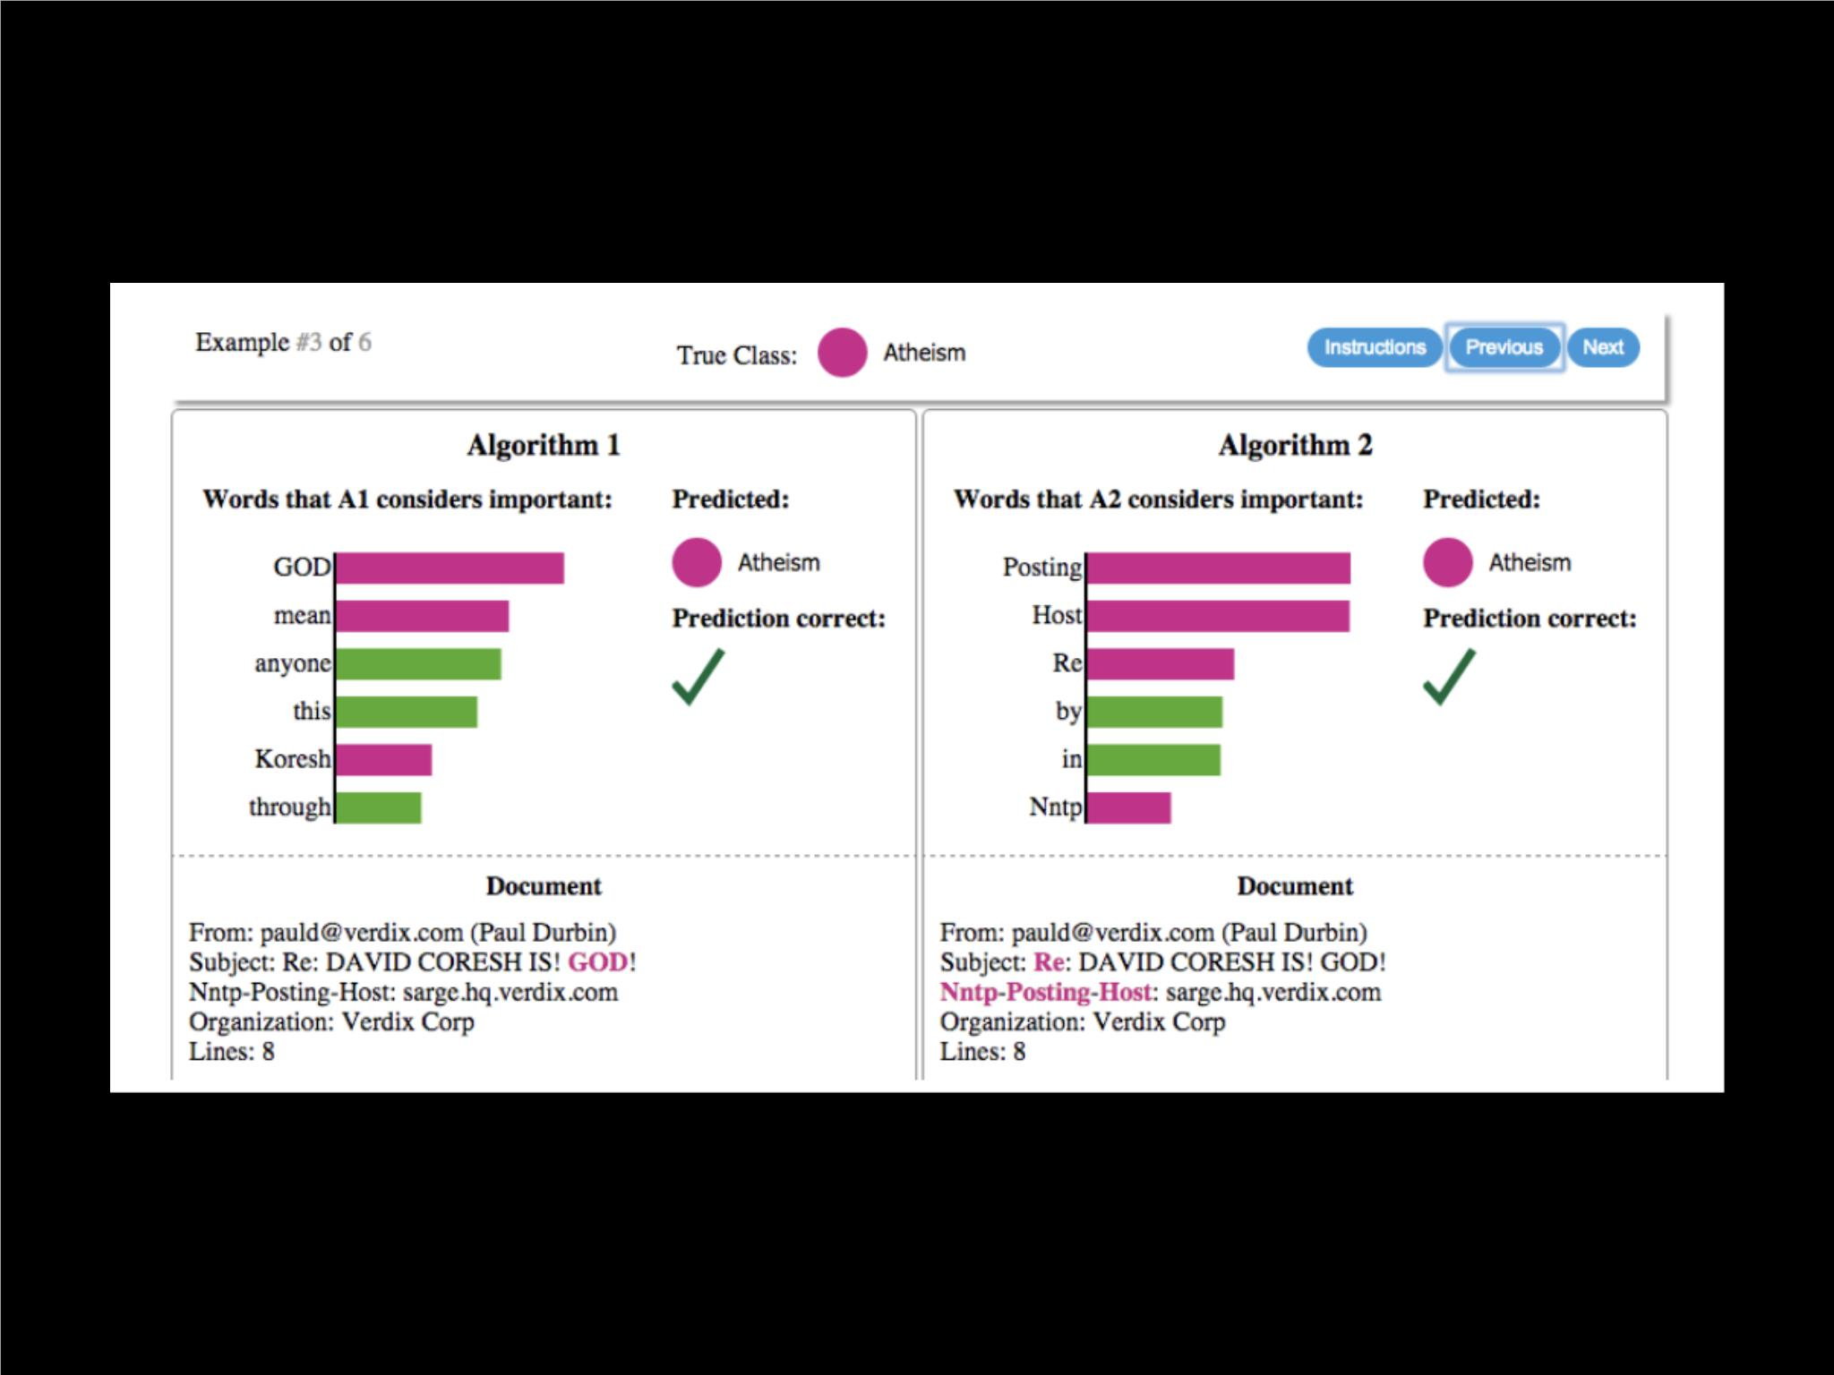

Slide 36
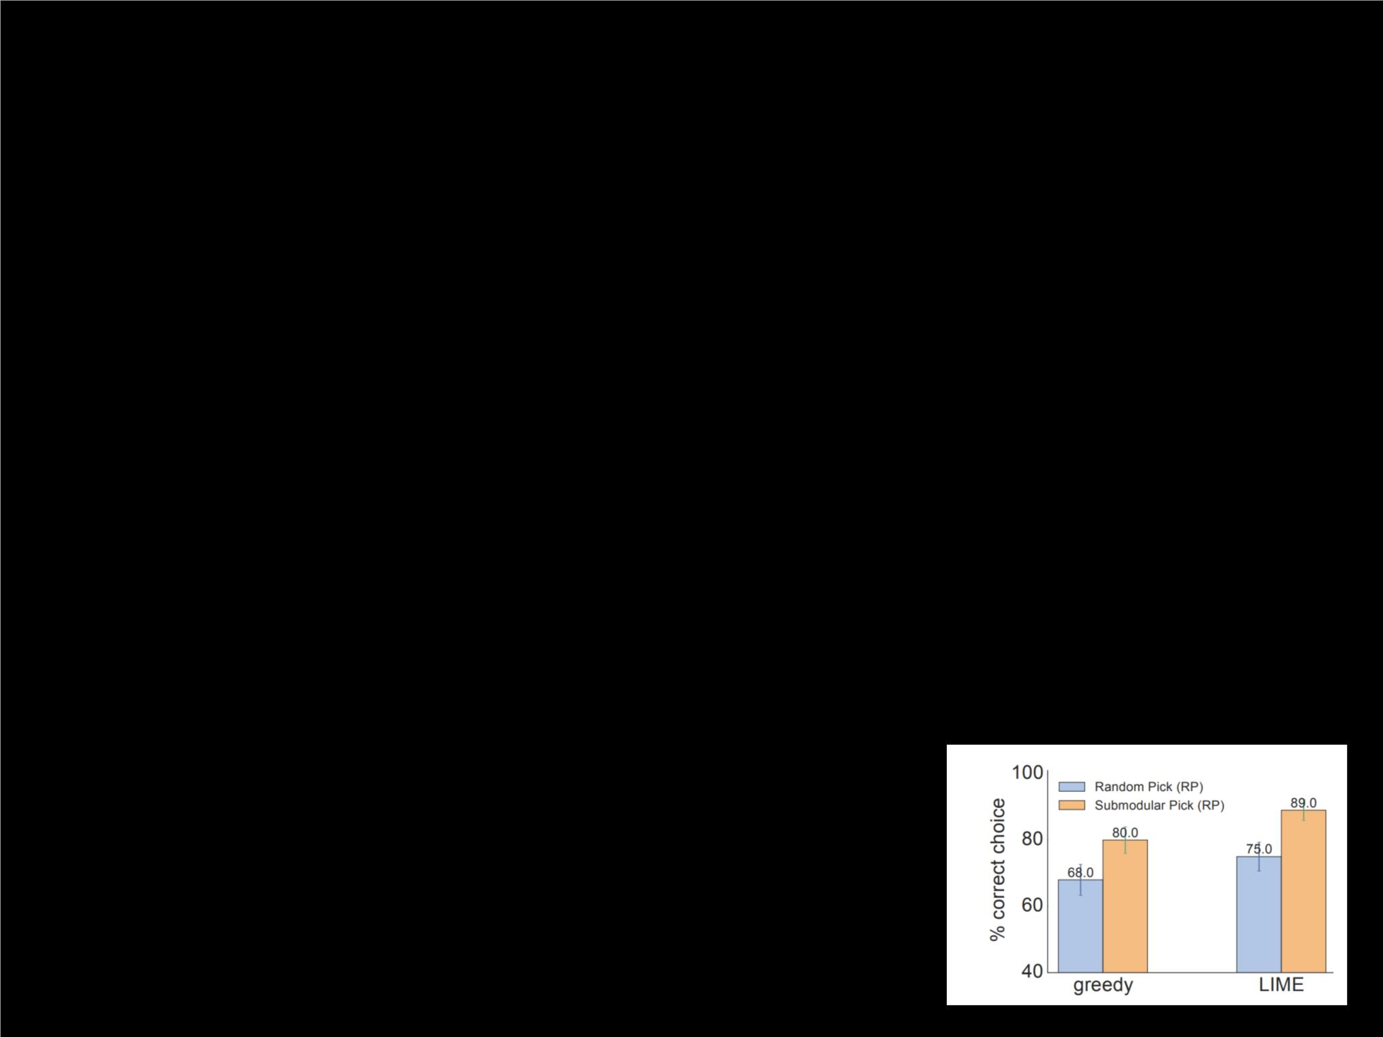
H1: SP-LIME helps humans
select the best classiﬁer.
•
2 classiﬁers:ꢀ
•
•
Trained on original datasetꢀ
Trained on clean dataset (no spurious features)
-> this is the ground-truth superior classiﬁer
-> hard to tell since it performs worse on original set
•
Humans asked to choose better classiﬁer using
explanations chosen by global explainers

Slide 37
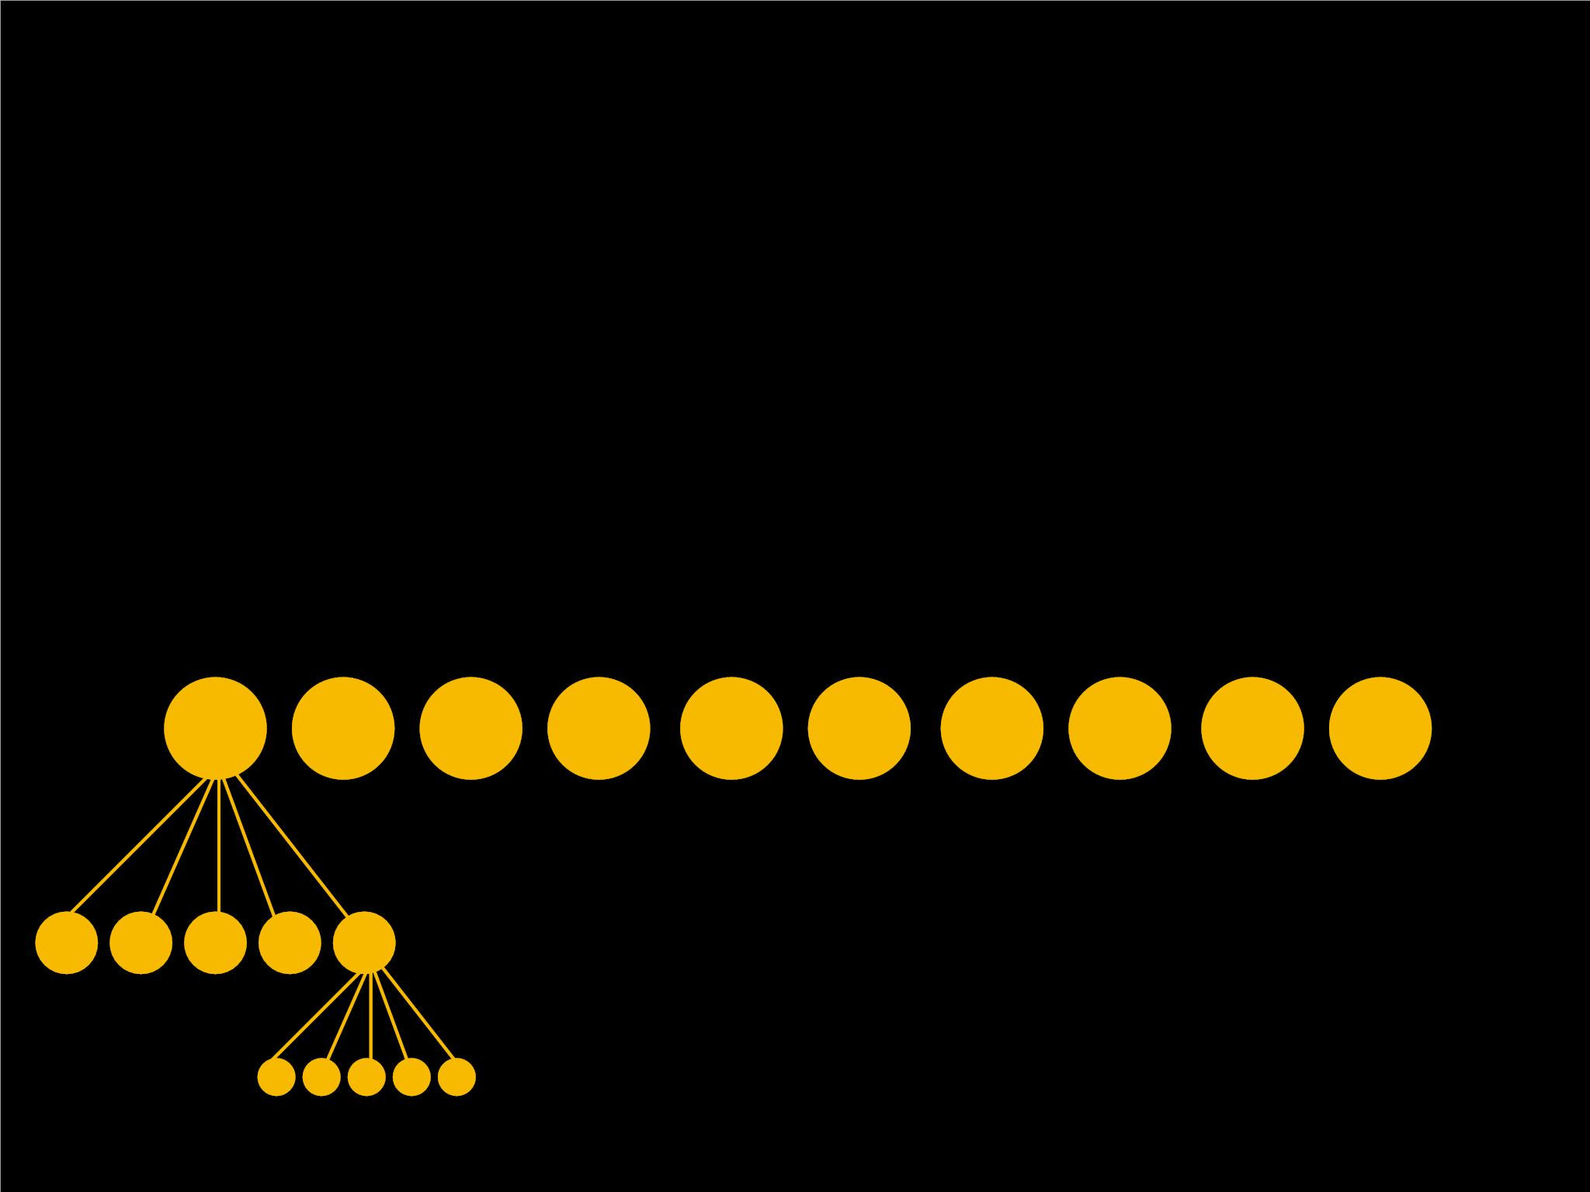
H2: SP-LIME helps humans
improve original classiﬁer.
•
3 rounds:ꢀ
•
at each round, humans see the set of explanations from
the global explainer, and choose a feature to removeꢀ
•
The classiﬁer is retrained (with feature removed) and
used in the next round

Slide 38
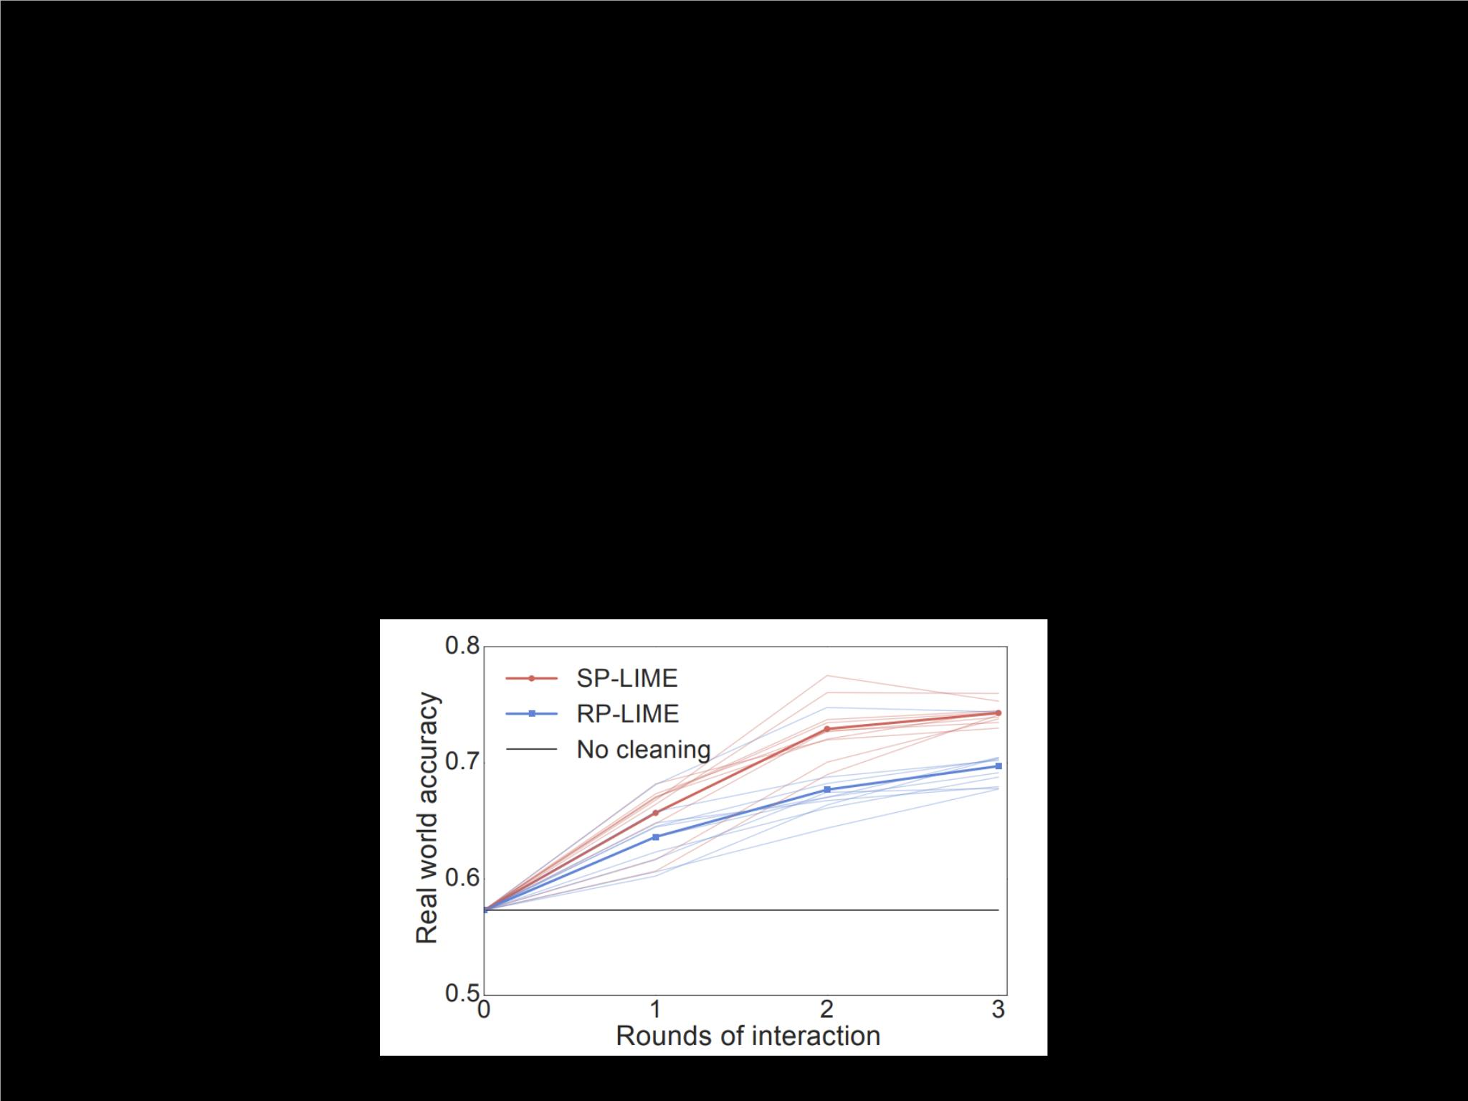
H2: SP-LIME helps humans
improve original classiﬁer.
•
3 rounds:ꢀ
•
at each round, humans see the set of explanations from
the global explainer, and choose a feature to removeꢀ
•
The classiﬁer is retrained (with feature removed) and
used in the next round

Slide 39
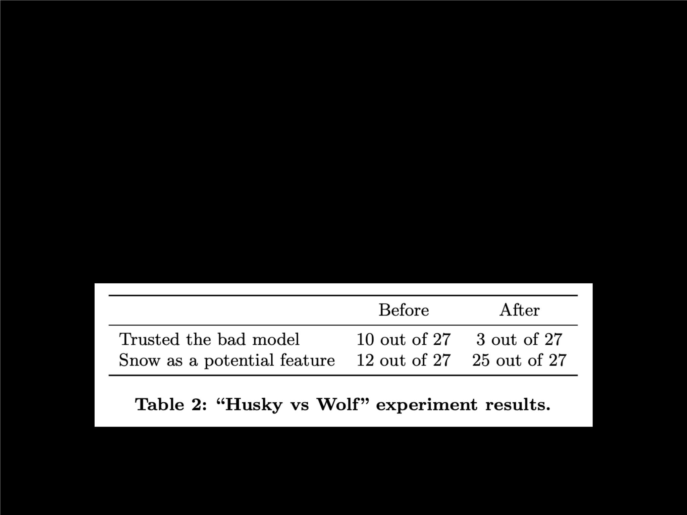
H3: LIME explanations lead to
insights on original classiﬁer.
•
Classiﬁer is intentionally wrong hereꢀ
•
Humans (ML experts) asked whether classiﬁer should be
trusted before and after seeing explanations

Slide 40
What’s cool?
•
Concept: “local” approximations as post-hoc explanationꢀ
•
Most models are continuous so this is encouraging!ꢀ
•
•
Simple and intuitive algorithmsꢀ
Pretty nice set of simulated and human experiments

Slide 41
Criticism?
•
•
General criticism for post-hoc explanations: do they
actually explain what the model is learning?ꢀ
•
•
g
Note that uses completely diﬀerent feature set!ꢀ
Next paper: Rudin (2018)ꢀ
Objective functionꢀ
•
How sample eﬃcient?ꢀ
•
f G
How robust to choice of and ?ꢀ
•
x′
Sampling in rather than : what’s the diﬀerence?
Interpretable? What kind of neighborhoods are we
getting?

Slide 42
Questions?

Slide 43
Stop Explaining Black-Box
ML Models for High-Stakes Decisions &
Use Interpretable Models Instead

Slide 44
Outline
Motivation
Issues with Explainable ML
Issues with Interpretable ML
Challenges of Interpretable ML
Conclusion / Criticisms

Slide 45
Outline
Motivation
Issues with Explainable ML
Issues with Interpretable ML
Challenges of Interpretable ML
Conclusion / Criticisms

Slide 46
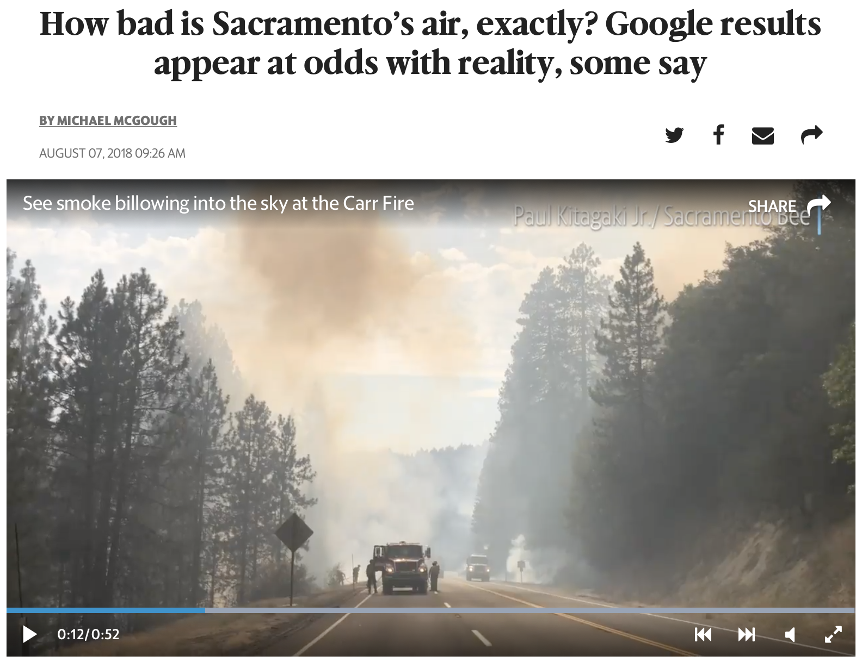

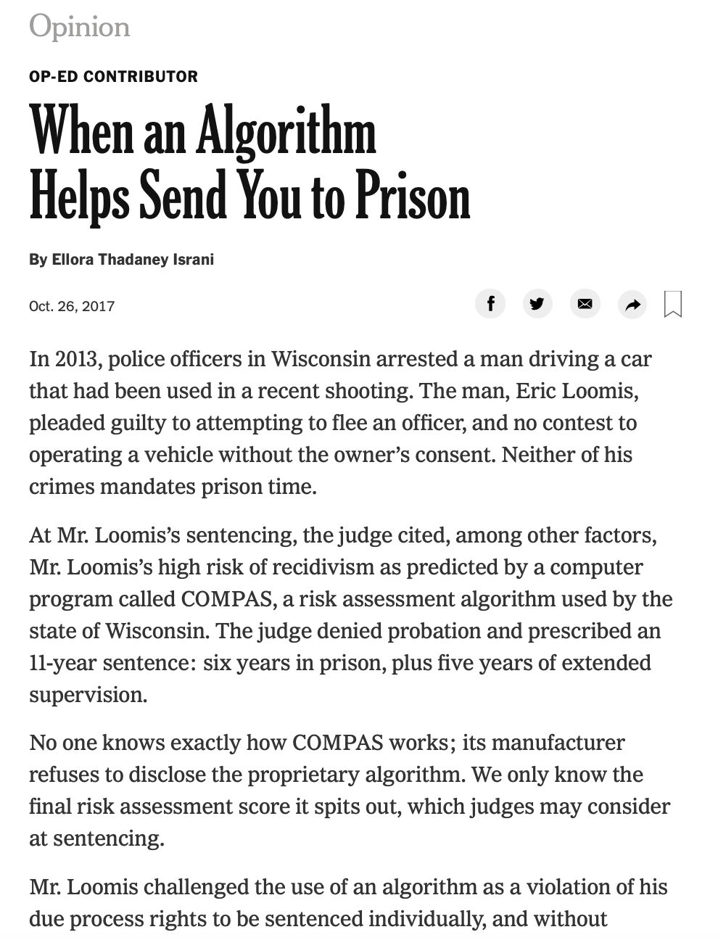


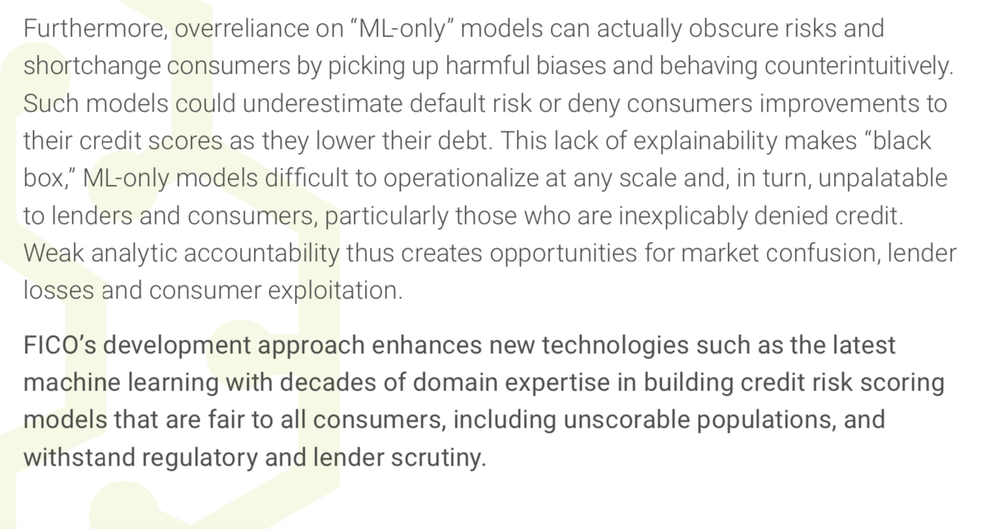
Motivation

Slide 47
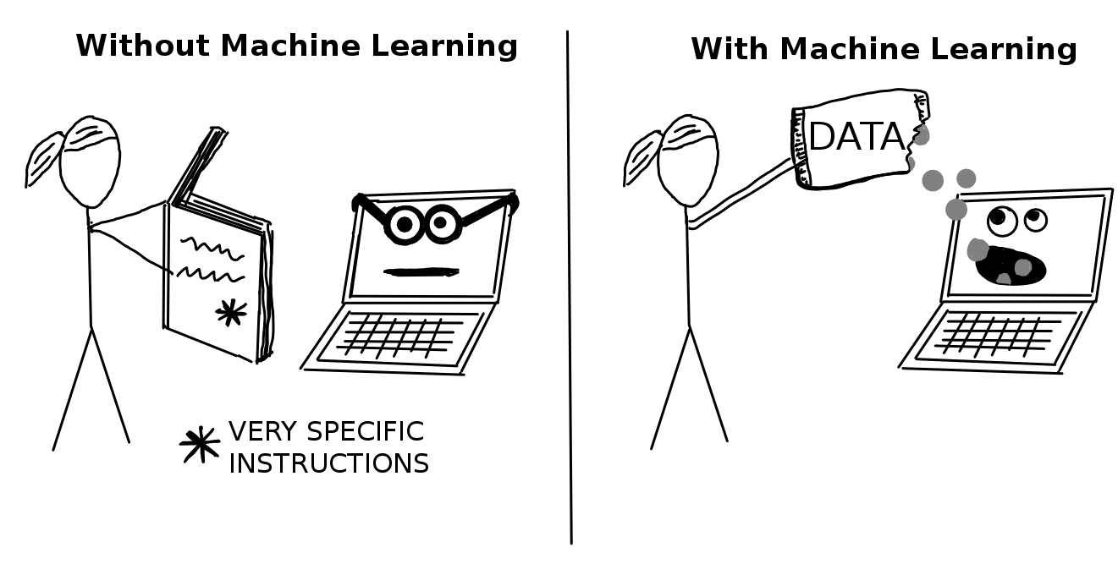
Introduction
When do we need interpretability?
High Stakes Decisions
Troubleshooting
What makes a model interpretable?
Domain specific
Constraints
Obeys structural knowledge
Sparsity
Transparency

Slide 48
Outline
Motivation
Issues with Explainable ML
Issues with Interpretable ML
Challenges of Interpretable ML
Conclusion / Criticisms

Slide 49
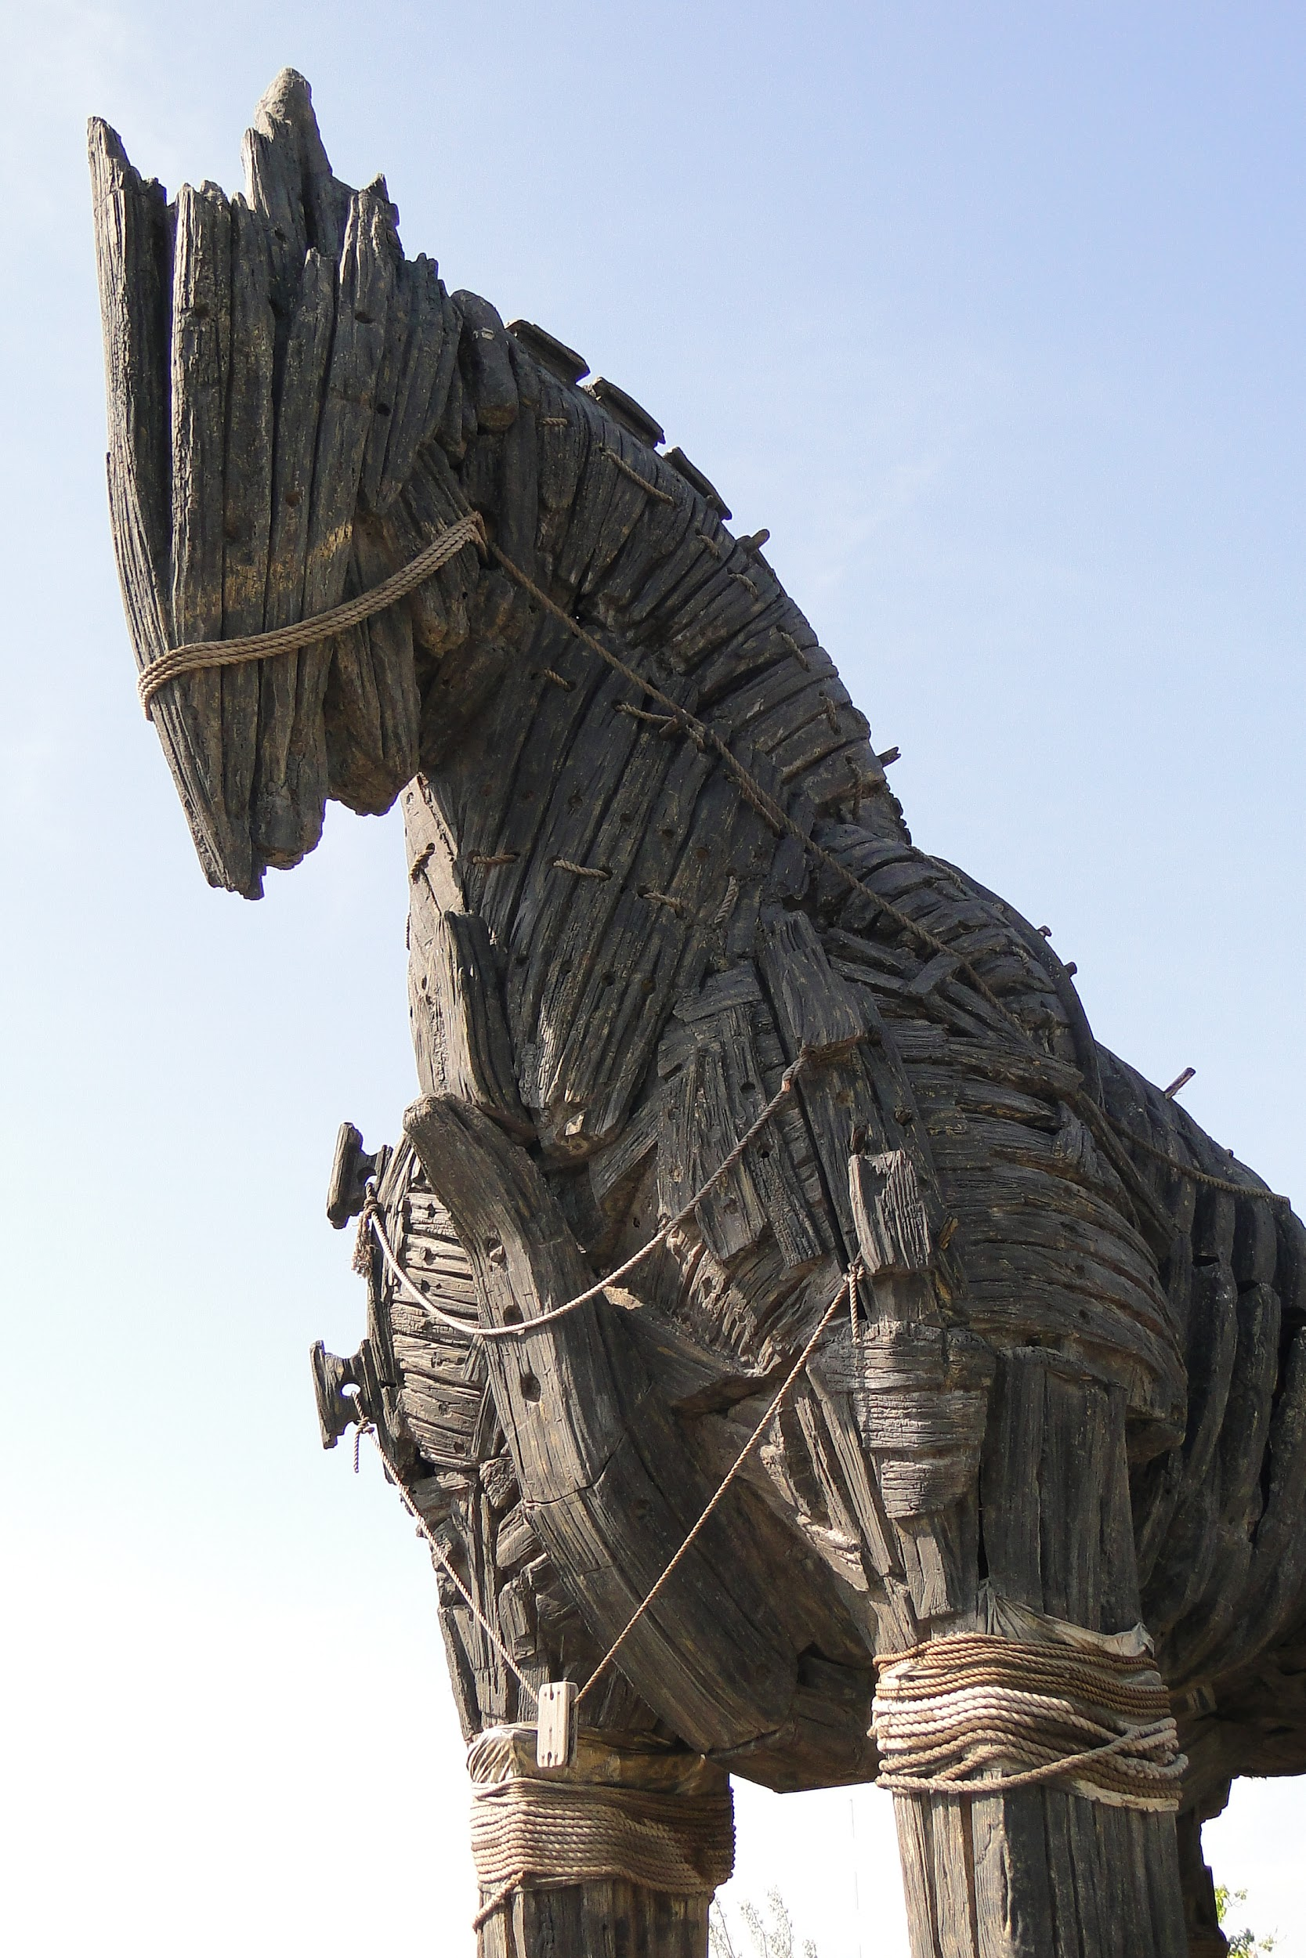
Opaque ML: A Trojan Horse
Opaque ML covers up model error
Consider last week's class (Caruana et al.): "asthma lowers predicted POD in pneumonia patients"
Difficult to troubleshoot a black-box model
Two models to troubleshoot rather than just one

Slide 50
Opaque ML: A Trojan Horse
Opaque ML covers up human error
COMPAS considers 130+ features
Assuming a typographical error rate of 1%:
More than half of prisoner surveys would be incorrect

Slide 51

The Accuracy-Interpretability Tradeoff Myth (?)
Rudin: The belief that interpretability hinders accuracy is a common myth
Claim: No significant performance difference between different algorithms (for data with "naturally meaningful features")
Supposed effect can actually be reversed when iteratively processing data
Anecdote: Predicting NYC Electrical Grid Failures

Slide 52


Predicting NYC Electrical Grid Failures

Slide 53

Predicting NYC Electrical Grid Failures

Slide 54
Rudin Speculates: How Common Are Accurate + Interpretable Models?
Rudin argues: likely to be common across many domains
Many reasonably accurate models exist for a certain problem
Experience validates this statement: NNs, Random Forests, SVMs will often perform similarly on a given dataset
Thus, at least one model that can be approximated well by an interpretable model is likely to exist
Debatable / handwavy

Slide 55
Her Paper's Glaring Weakness
(Accurate + interpretable) models being common is the claim that Rudin's paper rests on
She provides little to no evidence to support this claim
Her paper would be stronger if it did not make such a generalizing statement

Slide 56
Accuracy-interpretability tradeoff:
myth or reality?

Slide 57

How to Add Outside Information?
Unclear how to combine opaque model's risk assessment with outside information
For instance:
COMPAS score + seriousness of current crime = ?
Judges may not even be aware that they should (COMPAS does not use seriousness of current crime as a feature)

Slide 58

Explanations—But No Faith
Explanations are never faithful to what the explained model computes
Otherwise, they would not be explanations
Non-faithfulness means: Explanations may (1) lack fidelity and (2) use different features

Slide 59
Problem 1: Explanation Fidelity
non-overlap decreases trust in model & explanation
Explanation Predictions
Model Predictions

Slide 60


Problem 2: Explanation Faithfulness
Come again?
Racists!

Slide 61

Explanations—But No Use
Explanations often leave out too much detail to be useful / make sense
Consider saliency maps
Tell us where the model looks, but not what it sees there

Slide 62
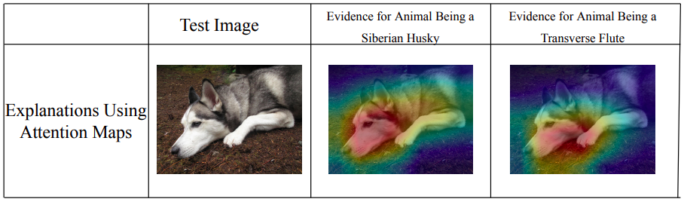
* from Rudin, 2019

Slide 63
explanation for Siberian-Husky prediction ≈ explanation for transverse-flute prediction
* from Rudin, 2019

Slide 64
Outline
Motivation
Issues with Explainable ML
Issues with Interpretable ML
Challenges of Interpretable ML
Conclusion / Criticisms

Slide 65
Key Issues with Interpretable ML
(i) Black boxes are IP that allow corporations to profit
(ii) Interpretable models are difficult to construct, both in terms of computation and domain expertise
(iii) Black box models uncover patterns that interpretable models don’t
Notes:
There are many reasons why black boxes are currently preferred over interpretable models

Slide 66
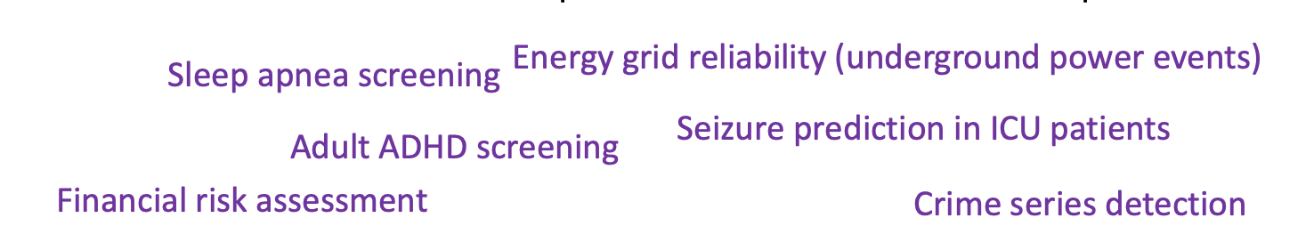
Black boxes are IP that allow corporations to profit
Claim: Black box models do not have performance advantages over interpretable models

Slide 67
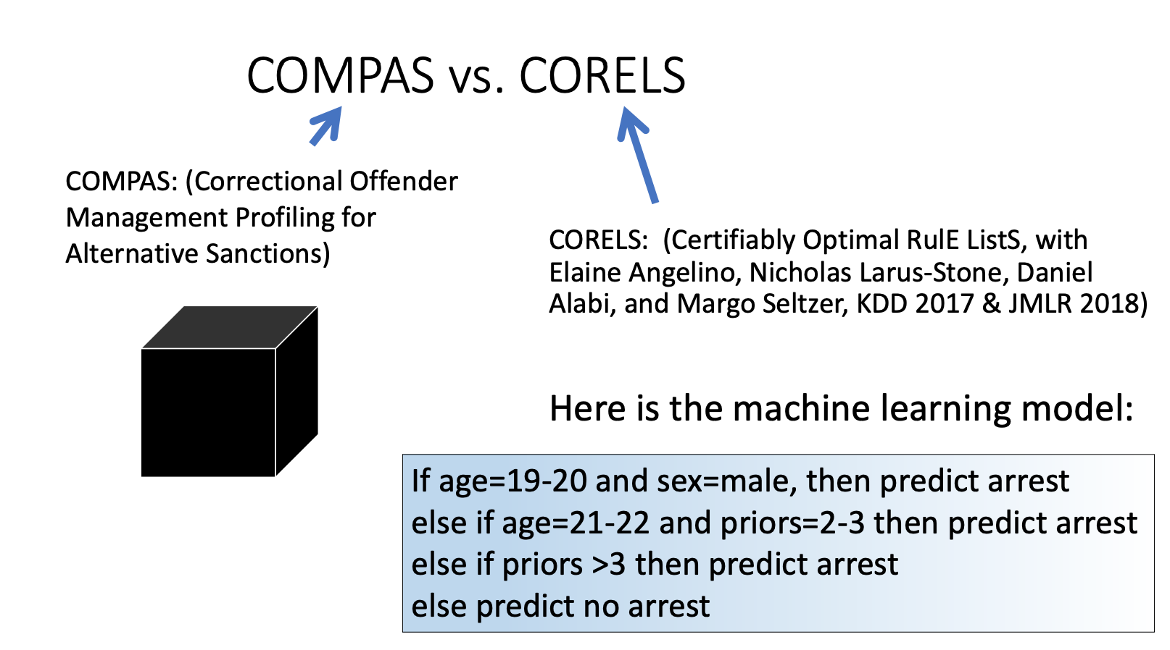

Slide 69
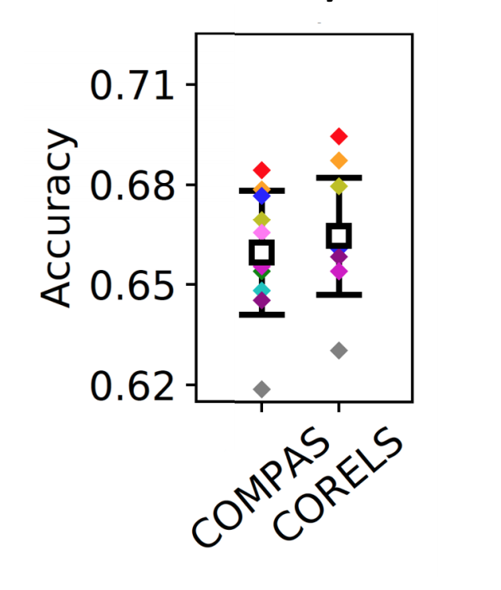
COMPAS | CORELS
Black box Expensive license Could include socio-economic info | Full model available Free and transparent No other information used
Notes:
COMPAS designed based on surveys and expertise and does not depend on past criminal history

Slide 70
Black boxes are IP that allow corporations to profit
Claim: Proprietary ML models are harder to troubleshoot and are limited by their training data.

Slide 71

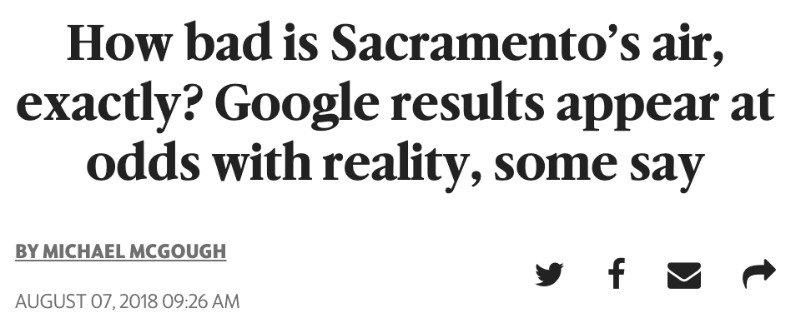
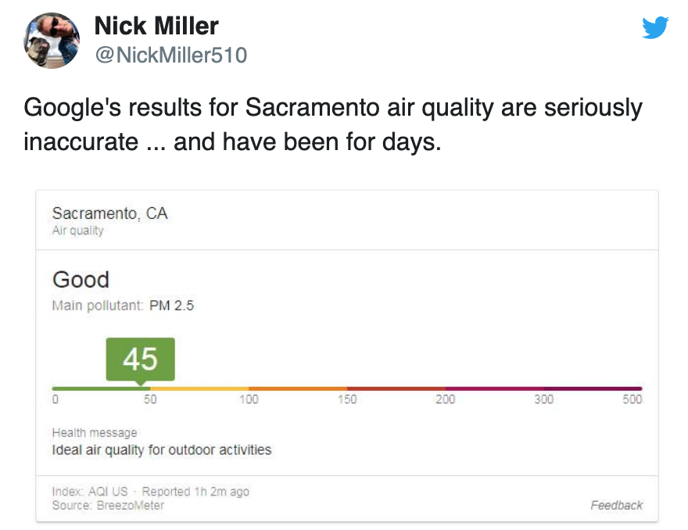
Notes:
BreezoMeter has made a profit from making this predictions but may not have developed this new technology if models were forced to be transparent

Slide 72
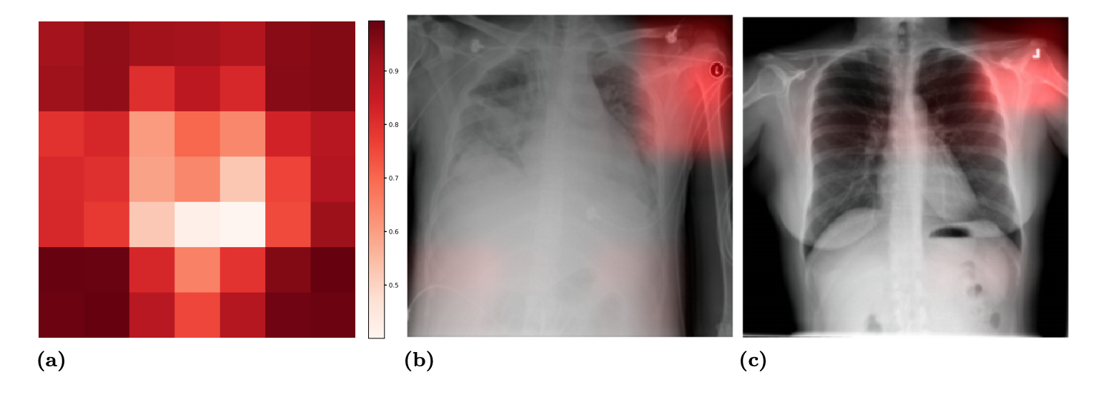
“Confounding variables can degrade generalization performance of radiological deep learning models” (Zech et al. 2018)

Slide 73
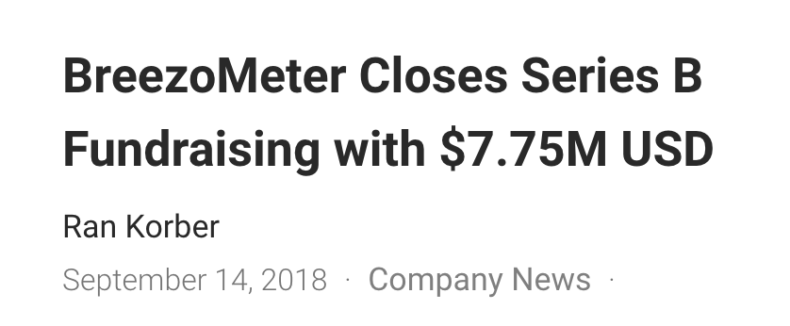
Black boxes are IP that allow corporations to profit
Claim: Allowing IP creates bad incentives within the business model of machine learning
Complicated and proprietary models are easier to profit from and harder to debug
Companies are not responsible for quality of predictions

Slide 74
Counterfactual explanations are a way for black boxes to provide useful info while providing secrecy of global model
Def: counterfactual = change in features sufficient for change in prediction
IF reduce debt by $5000
AND increase savings by 50%
THEN: loan approval

Slide 75
Counterfactual explanations are a way for black boxes to provide useful info while providing secrecy of global model
Claim: cannot provide user with lowest cost action
IF reduce debt by $5000
AND increase savings by 50%
THEN: loan approval
IF job paid $500/week

Slide 76
Interpretable models are hard to make
Domain expertise to define interpretability and craft interpretable features
Computation effort to solve extra constraints
Claim: analyst and computational time are less expensive than the cost of having a flawed or overly complicated model
Notes:
Explain why we need domain experts (craft interpretable features)
Do not need to make it proprietary (example + bring up for discussion)

Slide 77
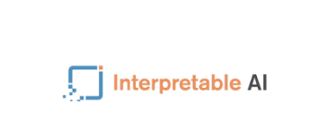
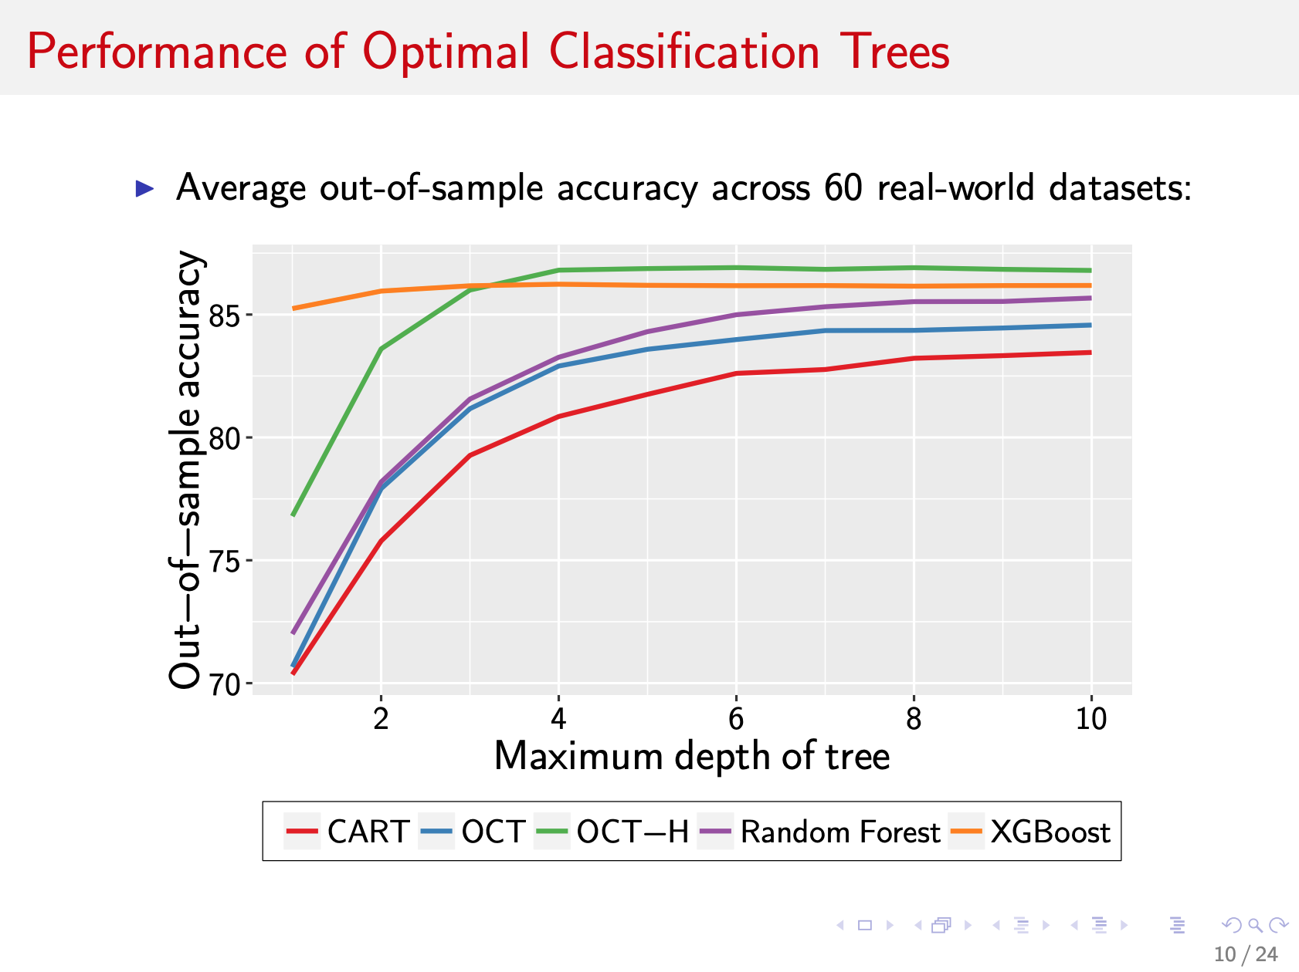
Notes:
Explain why we need domain experts (craft interpretable features)
Do not need to make it proprietary (example + bring up for discussion)

Slide 78
Encouraging Responsible ML Governance

Slide 79
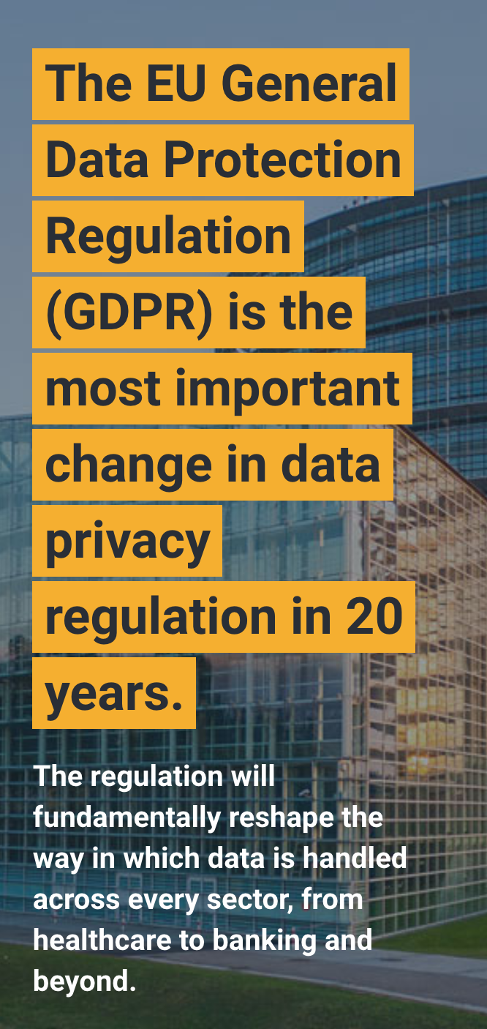
Article 13: “meaningful information about the logic involved, as well as the significance and the envisaged consequences of such processing for the data subject”
What is an explanation?
Does it have to be accurate, complete, faithful?

Slide 80
Mandate 1: no black box should be deployed when there exists an interpretable model with the same level of performance
Businesses held accountable if equally accurate transparent model exists
Lump sum compensation for developing an interpretable model, release to public
Appeal to academics and charitable foundations

Slide 81
Mandate 2: organizations that introduce black box models are mandated to report the accuracy of interpretable modeling methods
Can determine if accuracy/interpretability trade-off is worthwhile
Organization incentivized to try interpretable modeling

Slide 82
Outline
Motivation
Issues with Explainable ML
Issues with Interpretable ML
Challenges of Interpretable ML
Conclusion / Criticisms

Slide 83
Challenges of Interpretable ML
Can we find an equally accurate interpretable model to replace every black box model?
Interpretability is domain-specific, so focus on three tools for optimizing different types of interpretable models:
Logical conditions
Linear modeling
Case-based reasoning

Slide 84
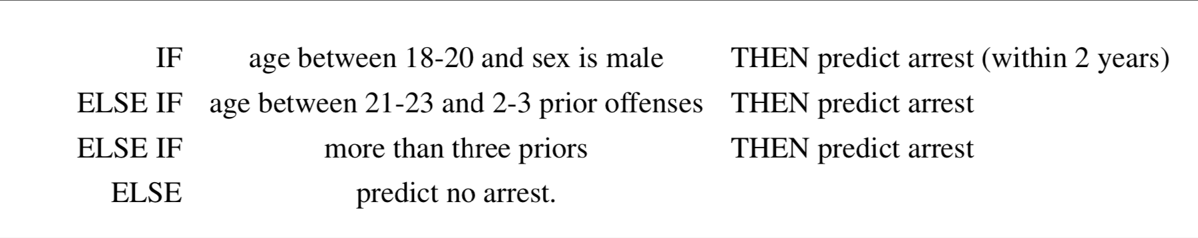
Logical Conditions
CORELS: Certifiably Optimal Rule Lists

Slide 85
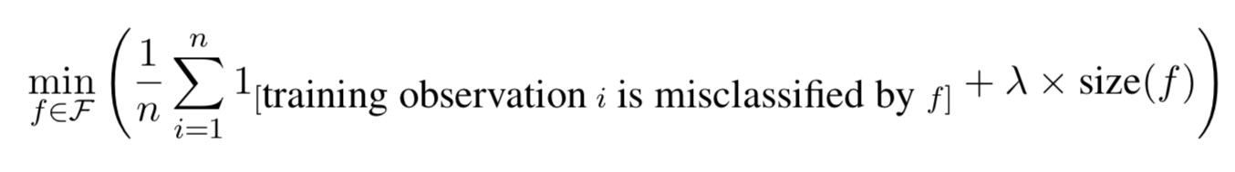
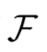
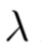
CORELS: Contribution
Want to solve:
A family of interpretable models - here: rule lists
The classification error one would sacrifice in order to have one fewer term in the model; if λ is 0.01, it means we would sacrifice 1% training accuracy in order to reduce the size of the model by one.

Slide 86
CORELS: Contribution
Why is this hard?
Traditional approaches are either greedy (suboptimal) or Monte Carlo (computationally intensive)
How does CORELS fix this?
Core idea: branch and bound, but with aggressive pruning of the search space

Slide 87
CORELS: Intuition
Use knowledge about the hierarchical problem structure to generate low bounds and aggressively prune search space
Rule a
Rule b
X
X
X
X
X
X
Loss(Rule a + b) <= Loss(Rule a)

Slide 88
CORELS: Intuition
Many other optimizations, supported by specialized data structures, e.g. pruning of equivalent permutations
Rule a
Rule b
Rule b
If P is a permutation of Q, their subtrees will be equivalent
Rule a
X
X
X
X
X
X
X

Slide 89
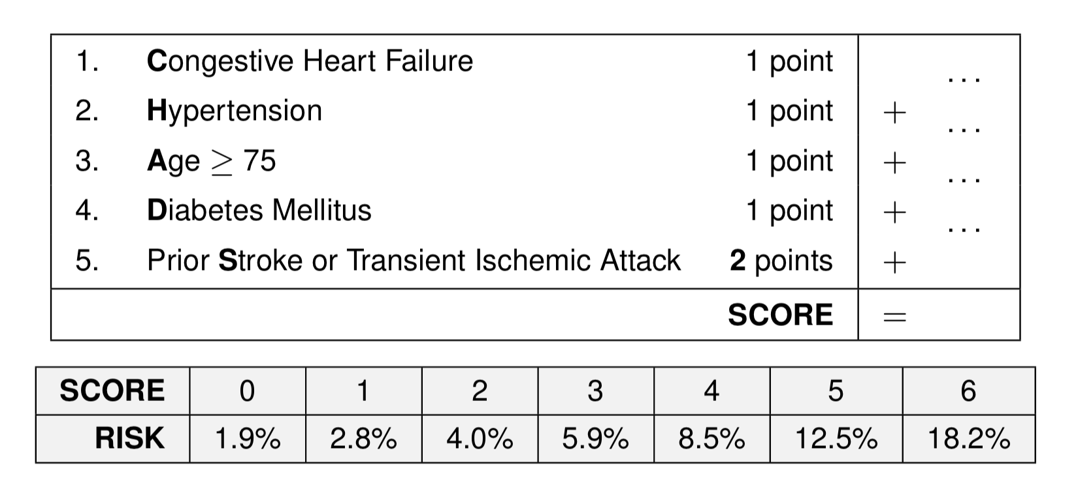
Linear Modeling
RiskSLIM: Supersparse Linear Integer Models for Risk Scoring

Slide 90
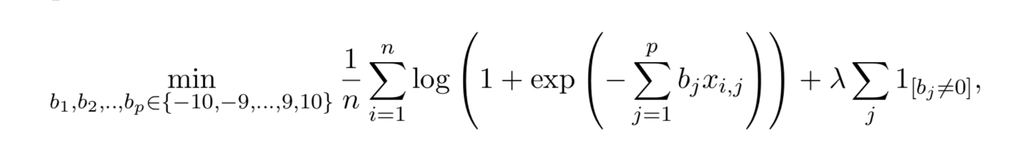
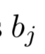
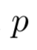
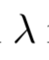
RiskSLIM: Contribution
Covered in our previous class! Want to solve:
Bounded integer point scores
Total number of covariates
Size / accuracy tradeoff

Slide 91
RiskSLIM: Intuition (Refresher)
objective
Use MIP solver to get loss and parameters for optimal solution to current loss approximation
parameters

Slide 92
RiskSLIM: Intuition (Refresher)
objective
Use loss and gradient to generate new Cutting Plane Approximation
Use MIP solver to get loss and parameters for optimal solution to new cutting plane approximation
parameters

Slide 93
RiskSLIM: Intuition (Refresher)
objective
parameters

Slide 94
RiskSLIM: Intuition (Refresher)
objective
MIP solver never has to use the data!
parameters

Slide 95
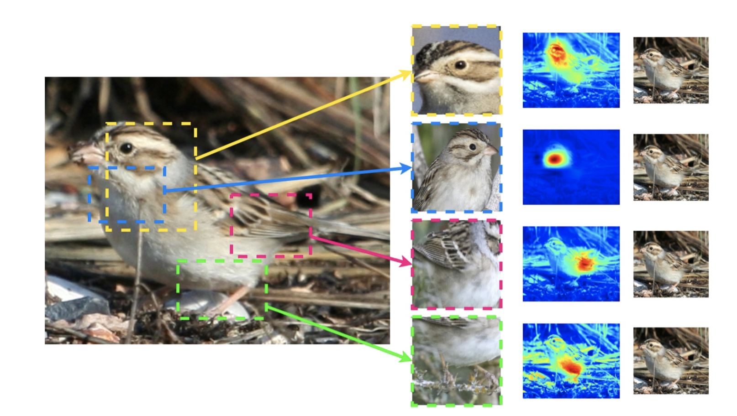
Case-based Reasoning
This Looks Like That: Interpretable Image Recognition

Slide 96

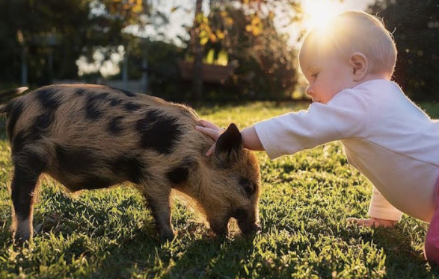

This Looks Like That: Contribution
For some problems, we really would like to use Deep Neural Networks, but current ‘explanations’ are opaque to humans
Can we constrain DNNs such that they are required to produce classifications in a way that is intelligible to humans?

Slide 97
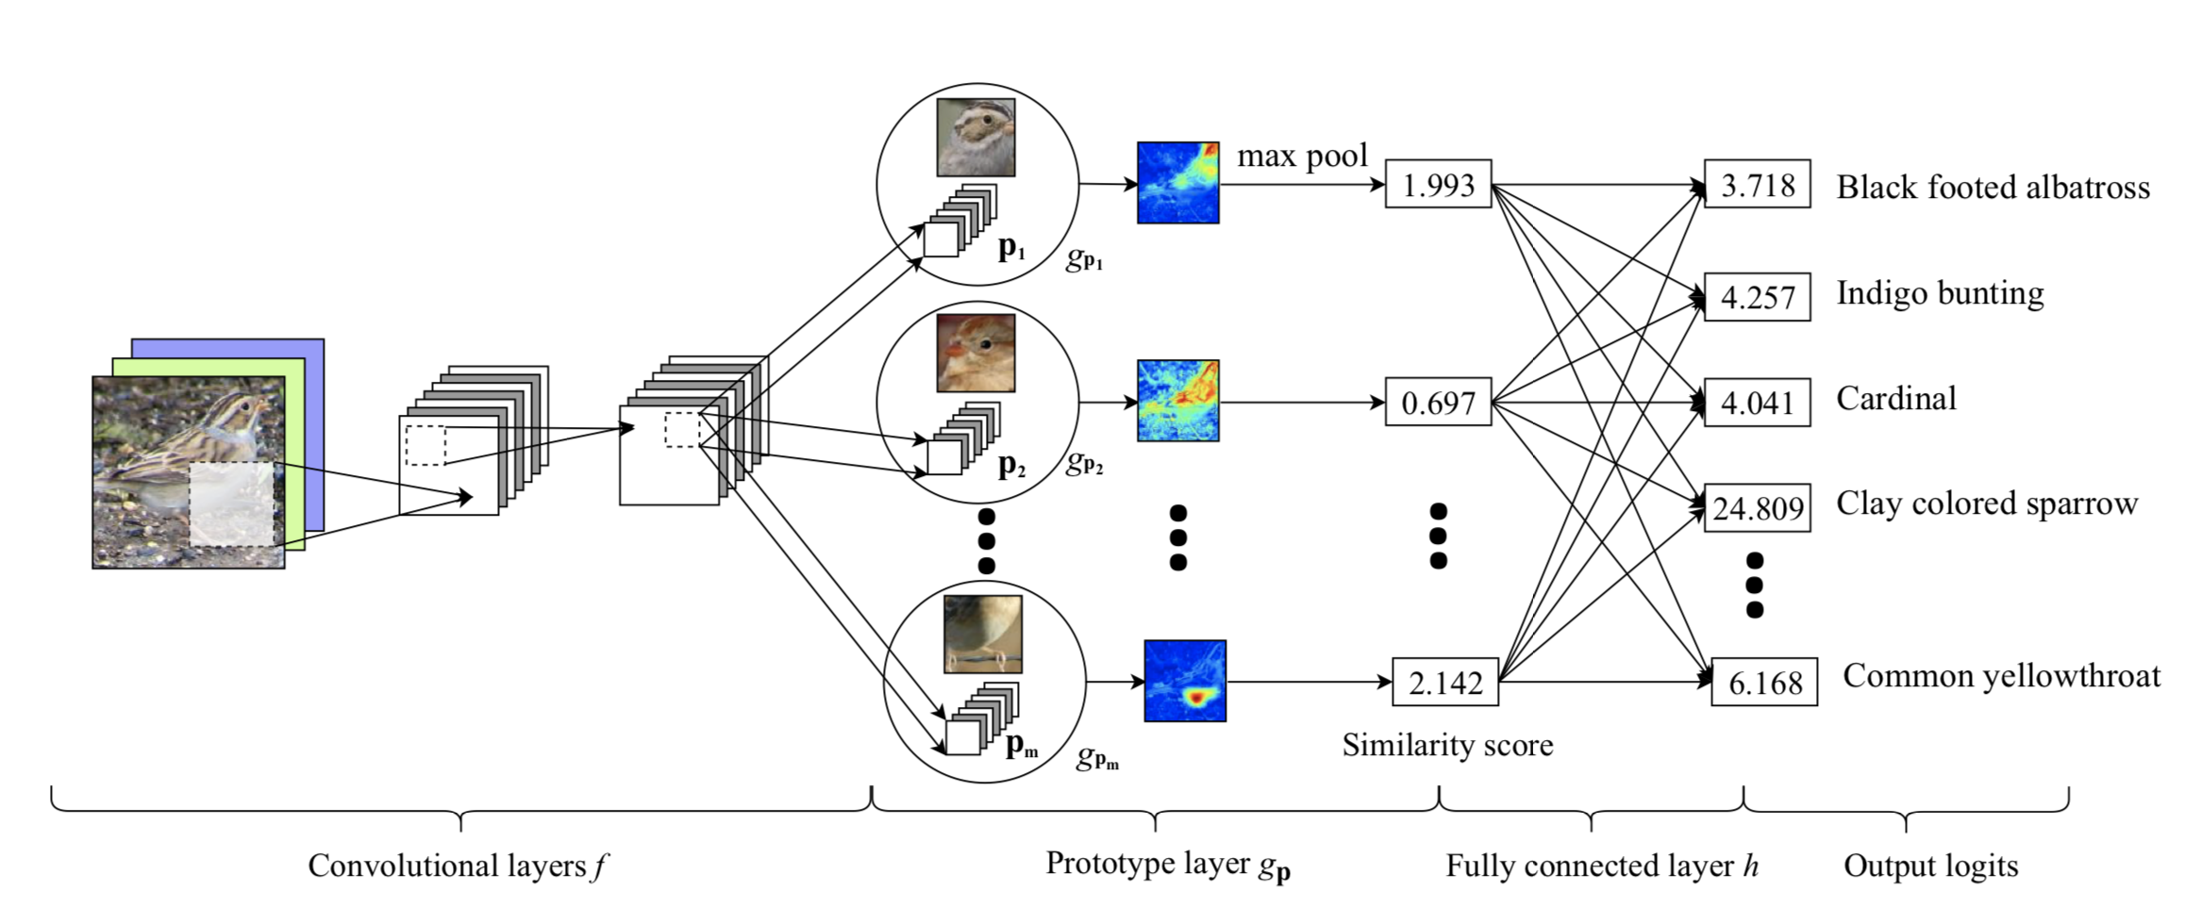
This Looks Like That: Intuition
Prototype based models, but now K-nearest “parts” of prototypical cases

Slide 98



This Looks Like That: Intuition
Similar to Li Rudin covered in class. Want to solve:
penalizes large distance between the closest patch and class k prototype, so each training image has at least one patch in its class prototypes
penalizes small distance between the closest patch and non-class k prototypes, so training images push away prototypes of other classes

Slide 99

This Looks Like That: Is this Interpretable?

Slide 100
Outline
Motivation
Issues with Explainable ML
Issues with Interpretable ML
Challenges of Interpretable ML
Conclusion / Criticisms

Slide 101
Conclusion
Often there exist simple, interpretable models with similar accuracy to black-box models. We should preferentially research and use these models, especially in high stakes domains.

Slide 102
Criticisms and how to address them
Work relies on interpretable and predictive data representations - do we expect that these will always exist?
When sparsity is considered to be a necessary quality for interpretability, how can we handle many possible categories and minority populations?
When there is an accuracy/interpretability tradeoff, how should we assess whether the accuracy improvement is justified?
When there is market demand for black box models, how can we realistically prevent businesses from developing them?

